Slide 1
Kinesiology 10B
Muscles of Ankle & Foot

Slide 2
Extrinsic Muscles
There are extrinsic and intrinsic muscles in the ankle and foot as in the wrist and hand. The extrinsic muscles originate on the leg, and the intrinsic muscles originate on the tarsal bones. The extrinsic muscles of the leg are found in groups of three or combinations of three and are located in three anatomical areas. All have proximal attachments on the femur, tibia, or fibula, and all cross the ankle joint. Table here summarizes these muscles. Assistive movers are the muscles indicated in parentheses. All other muscles listed are prime movers.

Slide 3
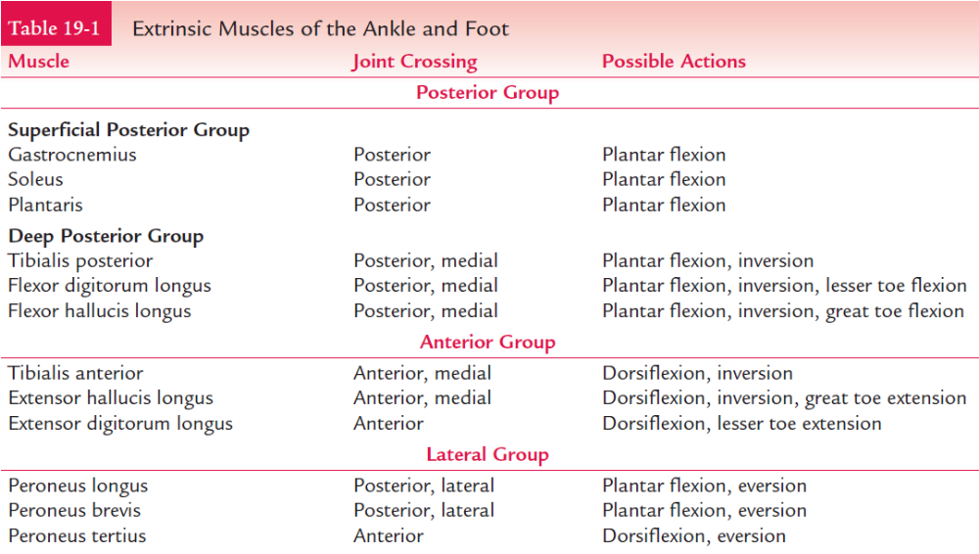

Slide 4
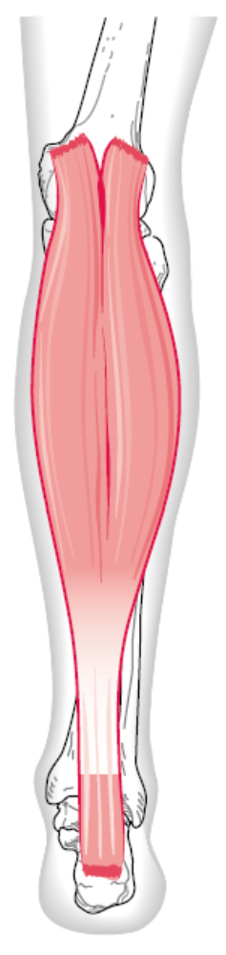
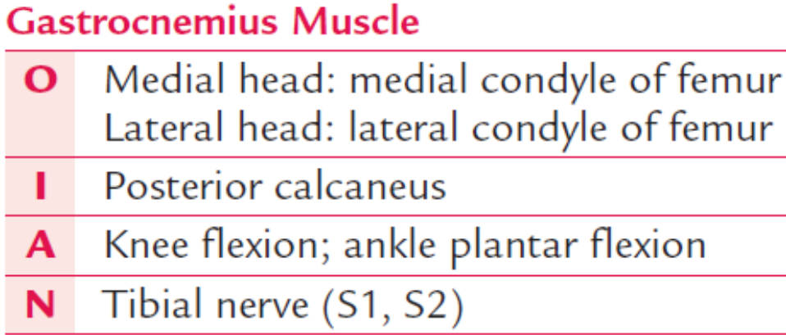
Superficial Posterior Group
The superficial posterior group includes the gastrocnemius, soleus, and plantaris muscles. Because the gastrocnemius muscle was described before. Its proximal attachment is posterior on the condyles of the femur, and its distal attachment is to the posterior calcaneus via the large Achilles tendon.

Slide 5
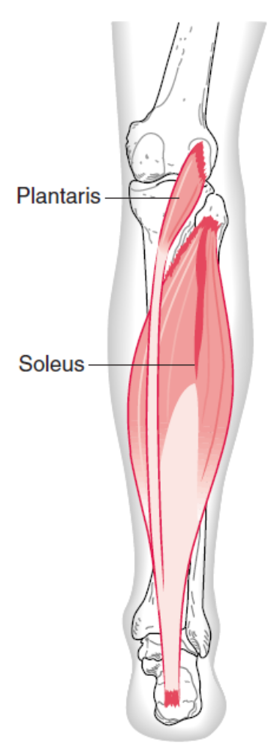
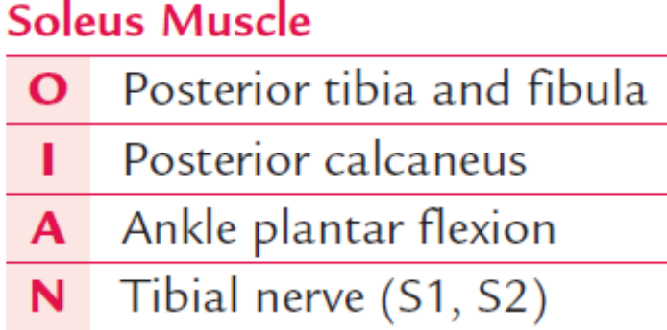
The soleus muscle is a large, one-joint muscle located deep to the gastrocnemius muscle. Originating on the posterior tibia and fibula, it spans the posterior leg, blending with the gastrocnemius muscle to form the large, strong Achilles tendon that inserts on the posterior calcaneus. Because the soleus muscle spans the ankle in the midline, its only function is to plantar flex the ankle. The two heads of the gastrocnemius and soleus muscles make up what is sometimes referred to as the triceps surae muscle, meaning “three-headed calf muscle.”

Slide 6
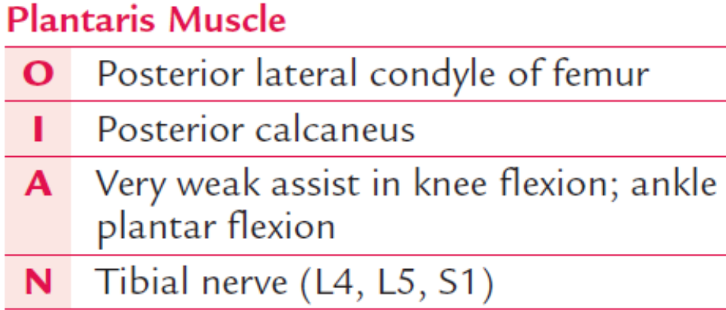
The plantaris muscle is a long, thin, two-joint muscle with no significant function. It originates on the posterior surface of the lateral epicondyle of the femur, spans the posterior leg medially, and blends with the gastrocnemius and soleus muscles in the Achilles tendon. Theoretically, it should flex the knee and plantar flex the ankle. However, because of its size in relation to the prime movers of those actions, it is assistive at best.

Slide 7
Deep Posterior Group
The deep posterior group is made up of the tibialis posterior, flexor hallucis longus, and flexor digitorum longus muscles. They all attach to the posterior tibia and/or fibula, and all terminate in the foot. Because they all cross the ankle posteriorly, they all can plantar flex it. However, because of their size in relation to the soleus and gastrocnemius muscles, their role is only assistive.

Slide 8
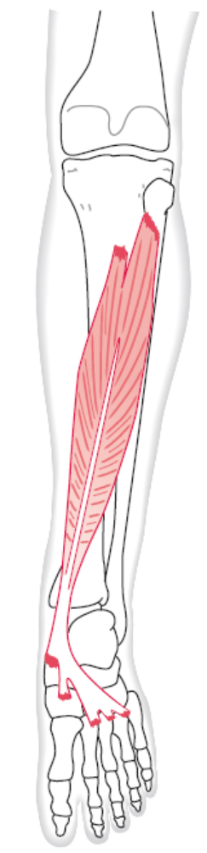
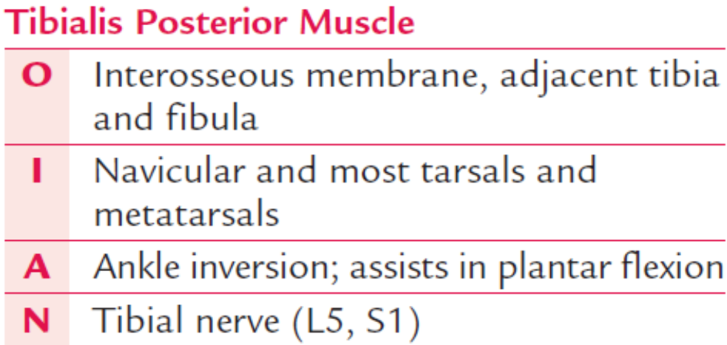
The tibialis posterior muscle is the deepest lying posterior muscle with its proximal attachment on the interosseous membrane and adjacent portions of the tibia and fibula. It descends on the posterior aspect of the leg, looping around the medial malleolus to attach on the navicular with fibrous expansions to the cuboid, the three cuneiforms, sustentaculum tali of the calcaneus, and the bases of the second through fourth metatarsals. Because the tibialis posterior muscle crosses the ankle medially and posteriorly, it can plantar flex and invert. Because of its size in relation to the other plantar flexors, it is assistive in this action.

Slide 9
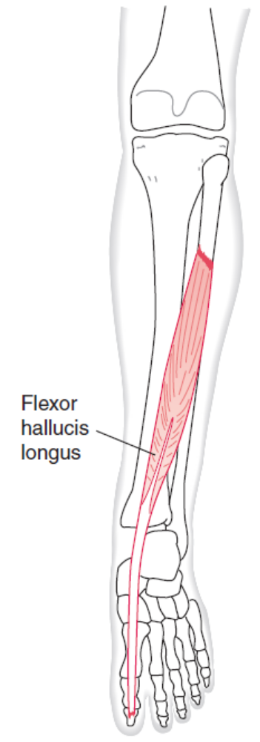
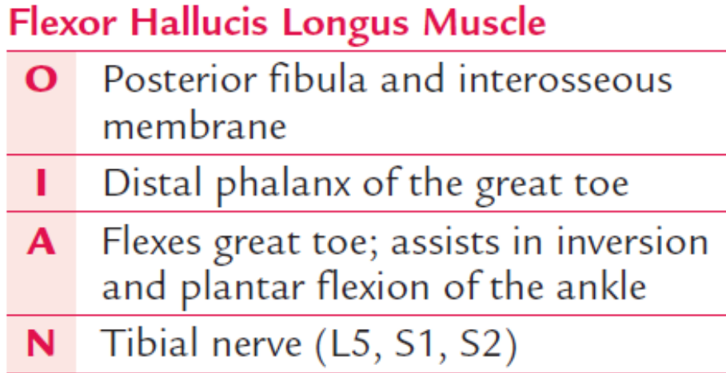
Situated mostly on the lateral side of the leg, the flexor hallucis longus muscle arises from the posterior fibula and interosseous membrane. It descends the leg posteriorly, loops around the medial malleolus through a groove in the posterior talus, and goes under the sustentaculum tali of the calcaneus. This muscle travels down the foot through the two heads of the flexor hallucis brevis muscle to attach at the base of the distal phalanx of the great toe. This distal attachment is similar to the flexor digitorum profundus and superficialis muscles in the hand. The flexor hallucis longus muscle flexes the great toe and assists in inversion and, to a lesser degree, assists in plantar flexion of the ankle.

Slide 10
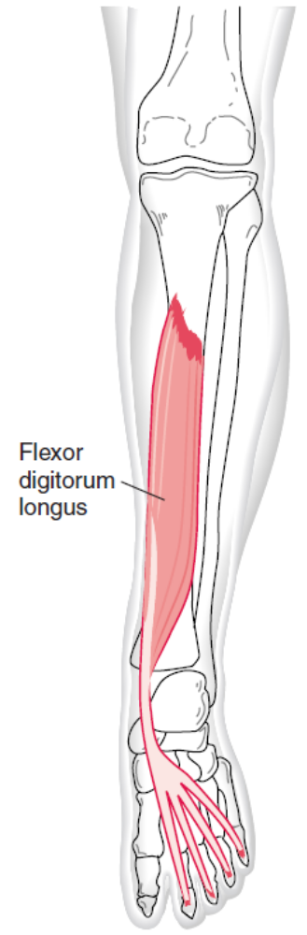
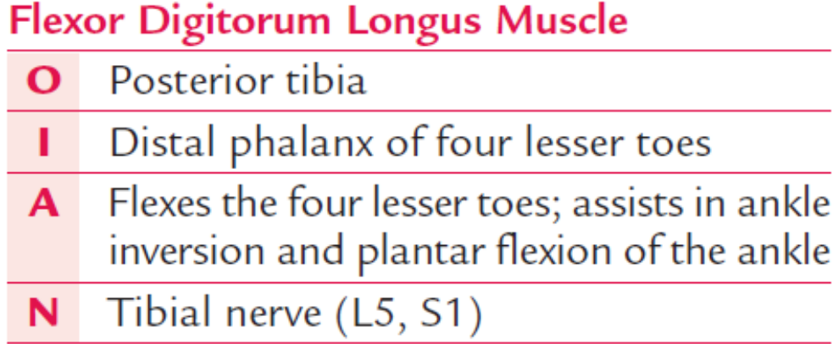
Situated mostly on the medial side of the leg, the flexor digitorum longus muscle arises from the posterior tibia. It descends the leg posteriorly, loops around the medial malleolus, and runs down the foot, splitting into four tendons to insert into the distal phalanx of the second through fifth toes. This muscle passes through the split in the flexor digitorum brevis tendon in a similar fashion to the flexor digitorum profundus muscle, which goes through the split in the flexor digitorum superficialis muscle in the hand. It flexes the four lesser toes and assists in inversion and plantar flexion of the ankle.

Slide 11
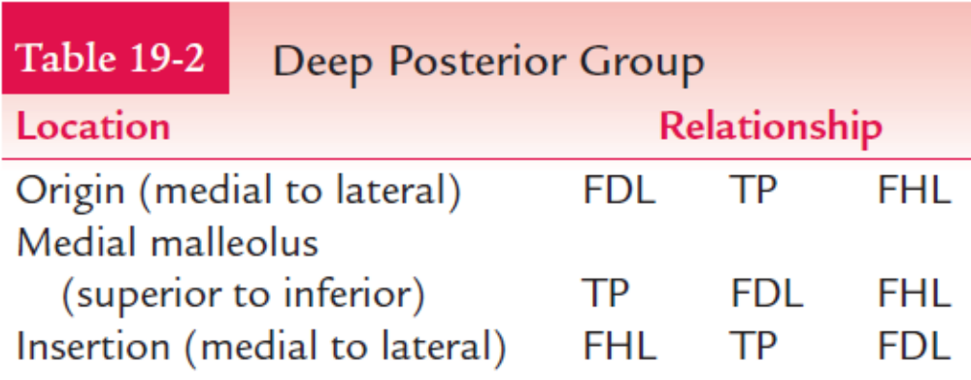
The relationships among the deep posterior muscles are interesting, crossing and intertwining with one another from their proximal to distal attachments. This feature provides added strength, much like a braided rope, which is stronger than one whose individual fibers run parallel to one another. Table 19-2 summarizes this changing relationship.

Slide 12
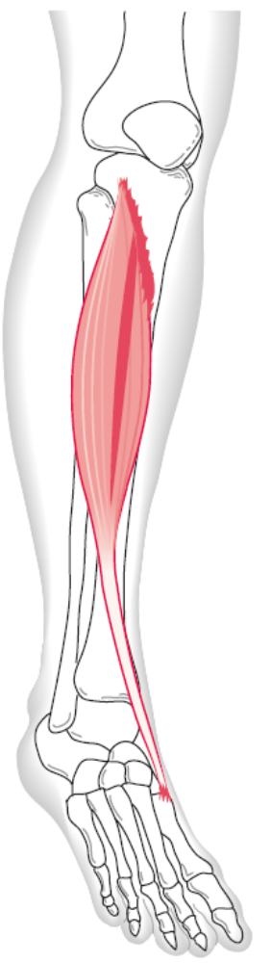
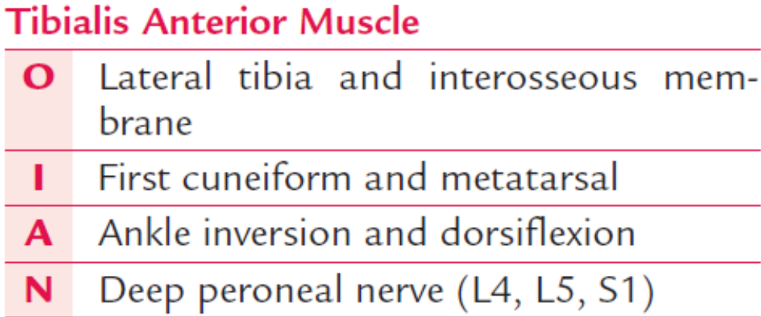
Anterior Group
The anterior muscle group is made up of the tibialis anterior, extensor hallucis longus, and the extensor digitorum longus muscles. They all attach proximally on the anterior lateral leg and cross the ankle anteriorly. The tibialis anterior muscle originates on the lateral side of the tibia and interosseous membrane, then descends the leg to insert medially on the first cuneiform and base of the first metatarsal. It makes up most of the bulk of the anterior lateral leg. Because the tibialis anterior muscle spans the ankle anteriorly and medially, it dorsiflexes and inverts the ankle.

Slide 13
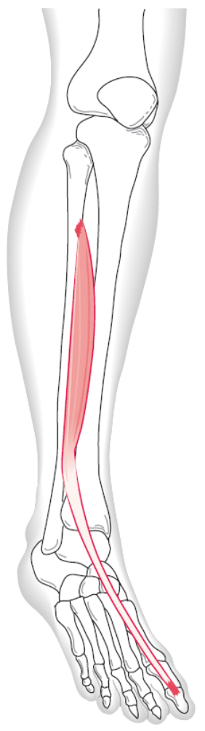
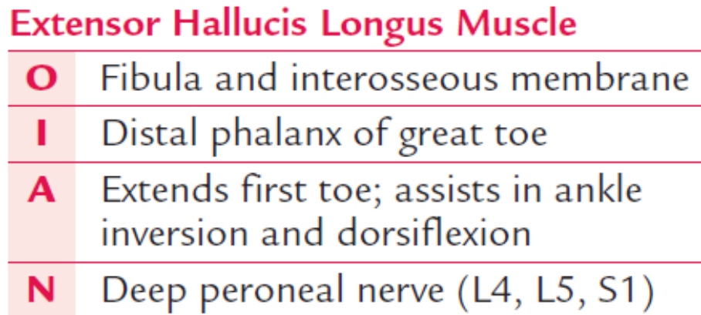
The extensor hallucis longus muscle, a thin muscle lying deep to and between the tibialis anterior and the extensor digitorum longus muscles, originates on the fibula and interosseous membrane and inserts into the base of the distal phalanx of the great toe. Its primary function is to extend the great toe, but this muscle also assists in dorsiflexing and inverting the ankle.

Slide 14
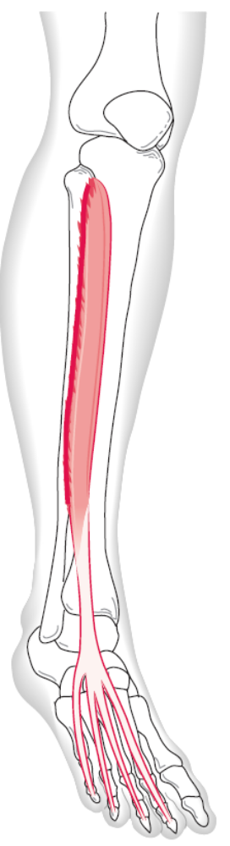
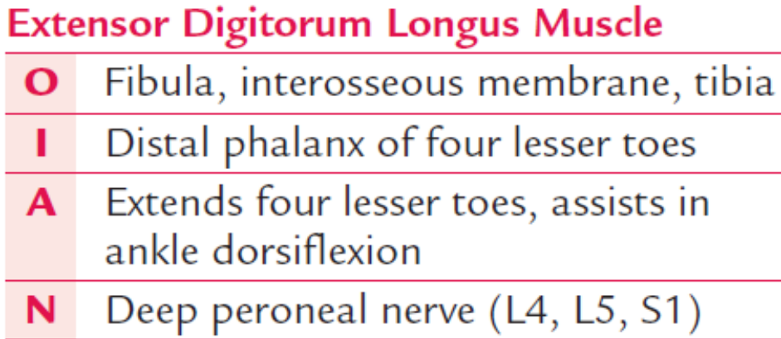
The most lateral of the anterior muscles, the extensor digitorum longus muscle attaches to most of the anterior fibula, interosseous membrane, and the lateral condyle of the tibia. It descends the leg to attach to the distal phalanx of the four lesser toes. The extensor digitorum longus muscle functions primarily to extend the second through fifth toes, but it also assists in dorsiflexing the ankle. It does not have an inversion/eversion role because it crosses the joint through the middle of that axis.

Slide 15
Lateral Group
The lateral group of muscles consists of the peroneus longus, peroneus brevis, and peroneus tertius muscles. They all originate proximally on the fibula and run distally to the foot. Two cross the ankle joint posteriorly, and one crosses the ankle anteriorly. The peroneus longus muscle is the more superficial of the peroneal muscles. Arising from the proximal end of the fibula and interosseous membrane, it descends the lateral leg and loops behind the lateral malleolus along with the peroneus brevis muscle. At this point the peroneus longus muscle goes deep to cross the foot obliquely from the lateral to the medial side of the foot to insert into the plantar surface of the first metatarsal and first cuneiform (Fig. 19-29). This distal attachment is very close to the attachment of the tibialis anterior muscle.

Slide 16
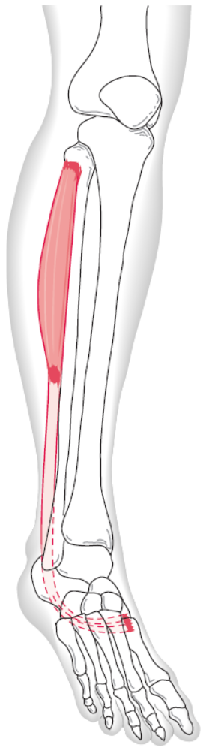
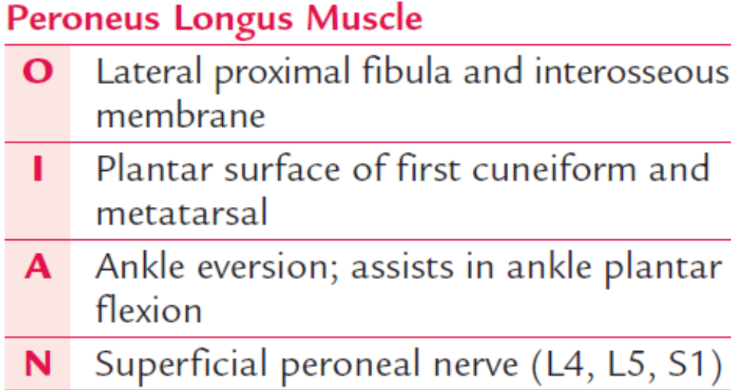
Together, the peroneus longus and tibialis anterior muscles are sometimes referred to as the stirrup of the foot because the peroneus longus muscle vertically descends the leg laterally before crossing the foot medially to join the tibialis anterior muscle. The tibialis anterior muscle vertically descends the leg medially to meet the peroneus longus muscle, forming a “U” or stirrup. Crossing the foot as it does, the peroneus longus muscle provides some support to the lateral longitudinal and transverse arches of the foot. Its prime function is to evert the ankle, although this muscle is able to assist somewhat in ankle plantar flexion.

Slide 17
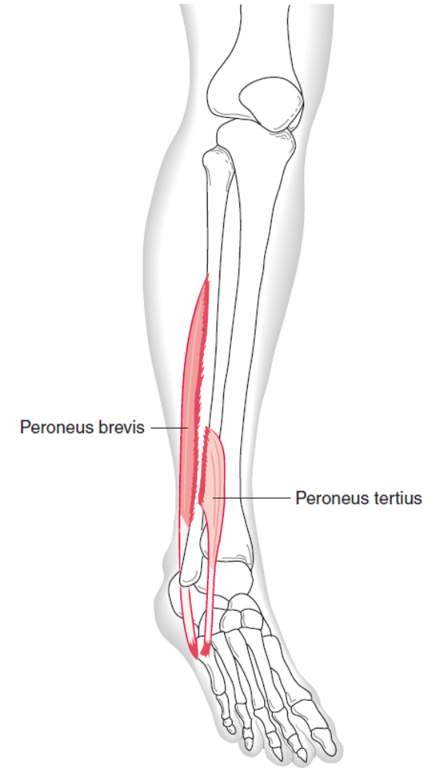
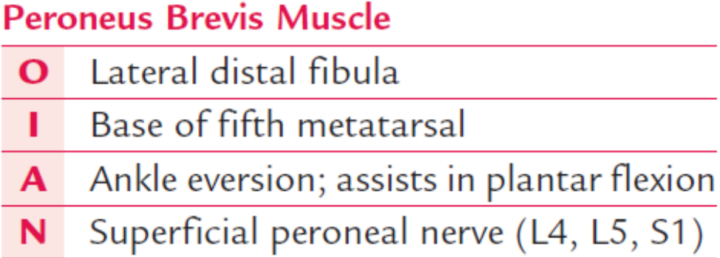
Deep to the peroneus longus muscle is the smaller, shorter peroneus brevis muscle. It attaches laterally on the distal fibula, descends the leg, and loops behind the lateral malleolus before coming forward to attach on the base of the fifth metatarsal. The peroneus brevis muscle is superficial from the lateral malleolus forward. Like the peroneus longus muscle, this muscle’s prime function is to evert the ankle, although it is able to assist somewhat in plantar flexion.

Slide 18
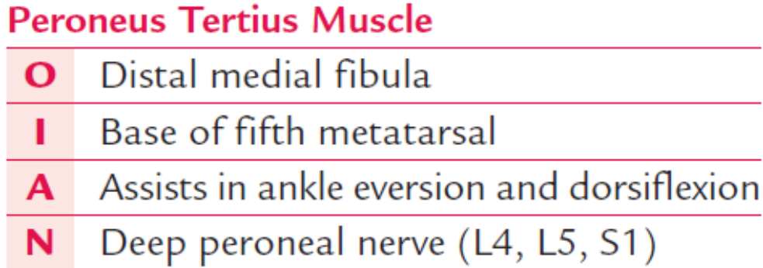
The peroneus tertius muscle, not present in all people, is difficult to identify and often is confused as part of the extensor digitorum longus muscle. The muscle arises from the distal medial fibula and interosseous membrane, and crosses the ankle anteriorly to insert on the dorsal surface of the base of the fifth metatarsal, near the peroneus brevis muscle. Theoretically, this muscle should dorsiflex and evert the ankle, but due to its size, it is assistive at best.

Slide 19
The following list summarizes the actions of the prime movers of the ankle.
Action Muscle
Plantar flexion Gastrocnemius, soleus
Dorsiflexion Tibialis anterior
Inversion Tibialis anterior, tibialis posterior
Eversion Peroneus longus, peroneus brevis
Flexion of second through fifth toes Flexor digitorum longus
Flexion of first toe Flexor hallucis longus
Extension of second through fifth toes Extensor digitorum longus
Extension of first toe Extensor hallucis Longus
No prime mover action Plantaris, peroneus tertius

Slide 20
Intrinsic Muscles
Intrinsic muscles have both attachments distal to the ankle joint. Because we do not use these muscles in the foot to perform intricate actions, they do not tend to be as well developed as their counterparts in the hand. Their names tell a great deal about their location and action. All intrinsic muscles are located on the plantar surface, essentially in layers, except the extensor digitorum brevis and extensor hallucis brevis muscles, which are on the dorsal surface. Table 19-3 summarizes the intrinsic muscles according to surface location, depth location, function, and similar structure in the hand. Innervation of these muscles is summarized as follows:

Slide 21
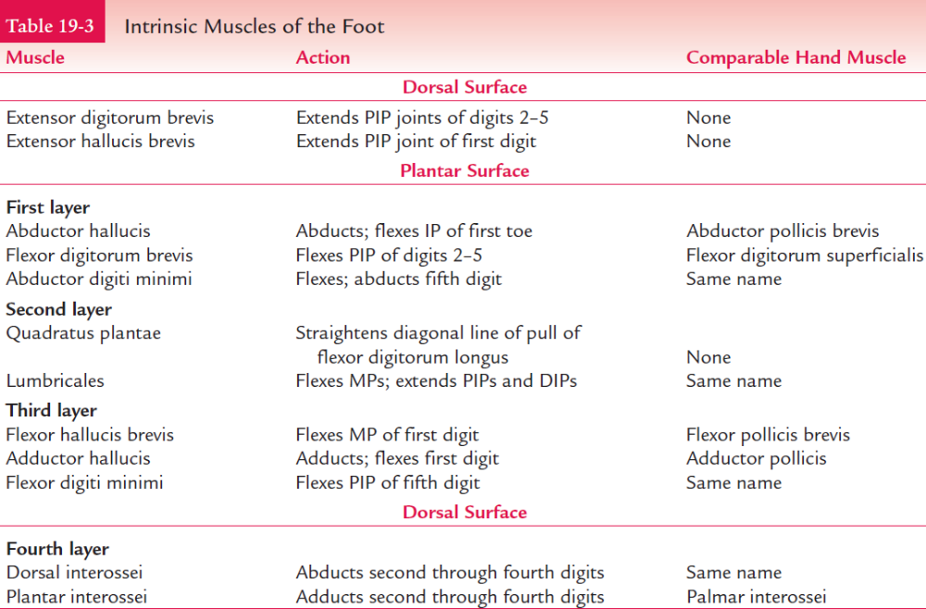

Slide 22
Muscle Nerve
DORSAL SURFACE
Extensor digitorum brevis Deep peroneal
Extensor hallucis brevis Deep peroneal
PLANTAR SURFACE
Abductor hallucis Tibial
Flexor digitorum brevis Tibial
Abductor digiti minimi Tibial
Quadratus plantae Tibial
Lumbricales Tibial
Flexor hallucis brevis Tibial
Adductor hallucis Tibial
Flexor digiti minimi Tibial
Dorsal interossei Tibial
Plantar interossei Tibial

Slide 23
Summary of Muscle Innervation
The ankle and foot muscles fall into relatively tidy groupings according to innervation. Those muscles located on the posterior leg and plantar surface of the foot receive innervation from the tibial nerve. The plantar foot divides into two groups similar to the hand. The lateral plantar branch of the tibial nerve innervates muscles located on the lateral side, and the medial plantar branch innervates those on the medial side. The superficial peroneal nerve innervates muscles on the lateral side of the leg (peroneals). The peroneus tertius muscle is the exception, because it crosses the ankle anteriorly to receive innervation with the other anterior muscles from the deep peroneal nerve.

Slide 24
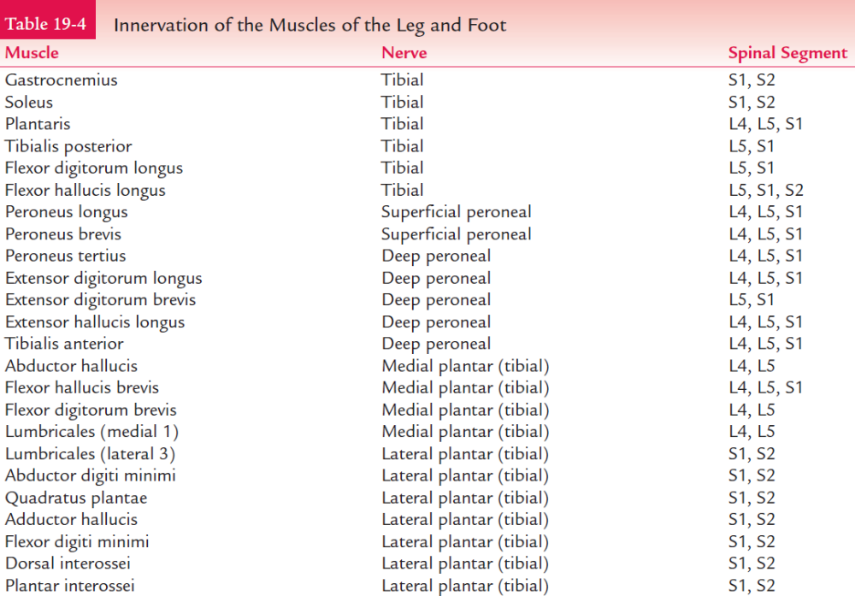

Slide 25
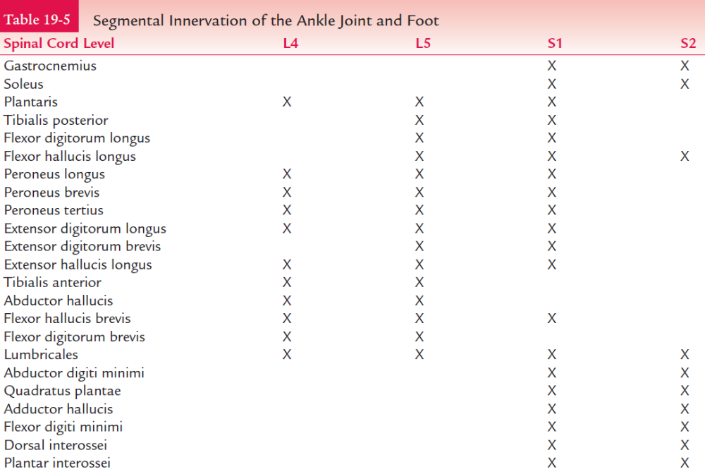

Slide 26
Points to Remember
• Stretching is performed on relaxed muscles, strengthening is occurring on contracting muscles.
• To stretch a two-joint muscle, stretch it over both joints at the same time within pain limits of that muscle.
• To stretch a one-joint muscle, select a joint position that stretches a two-joint muscle over only one joint.
• The excursion of a one-joint muscle will be greater than the range allowed by the joint.

Slide 27
• The excursion of a two-joint muscle is less than the combined range allowed by both joints.
• A muscle contraction is strongest if the muscle is stretched before it contracts.
• A muscle loses power quickly as it shortens.
• Two-joint muscles maintain their force of contraction for a longer period compared to a one joint muscle. This is because they are able to elongate over one joint while shortening over the other joint.

