Slide 1
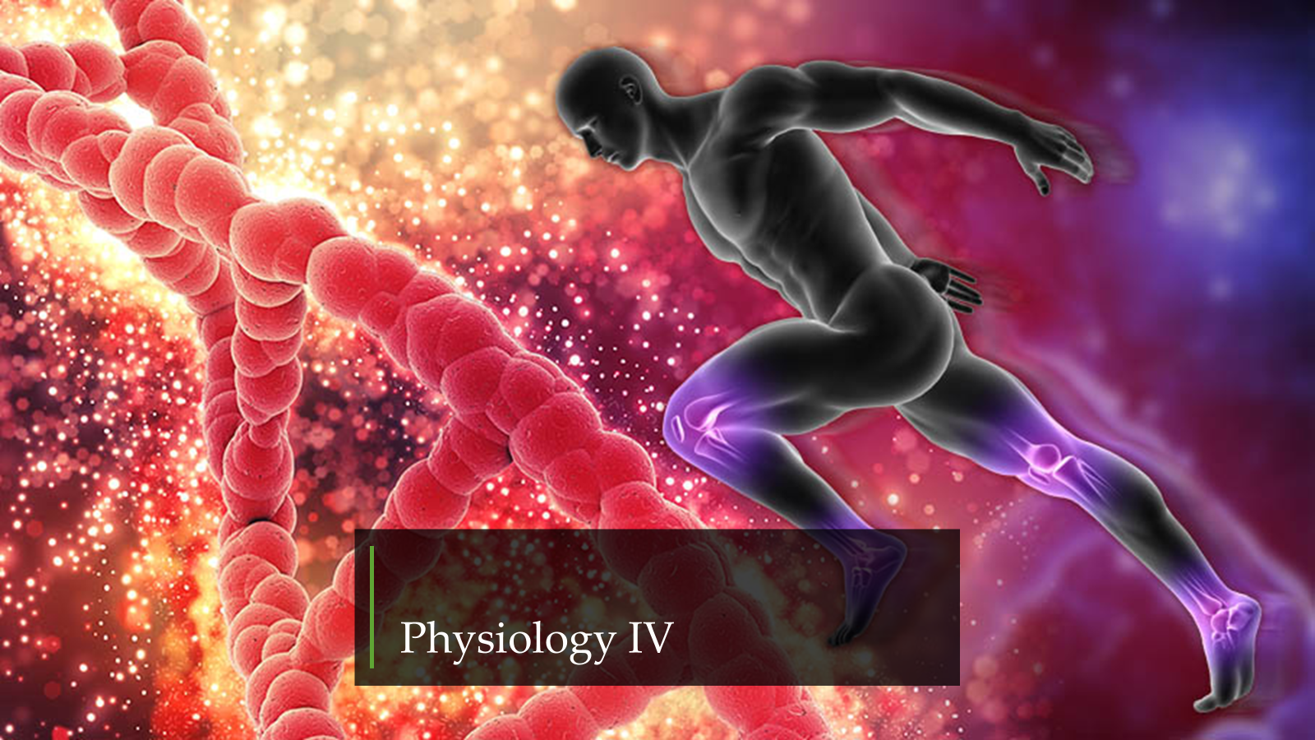

Slide 2
Genetic 2
Genetic basis of disease

Slide 3
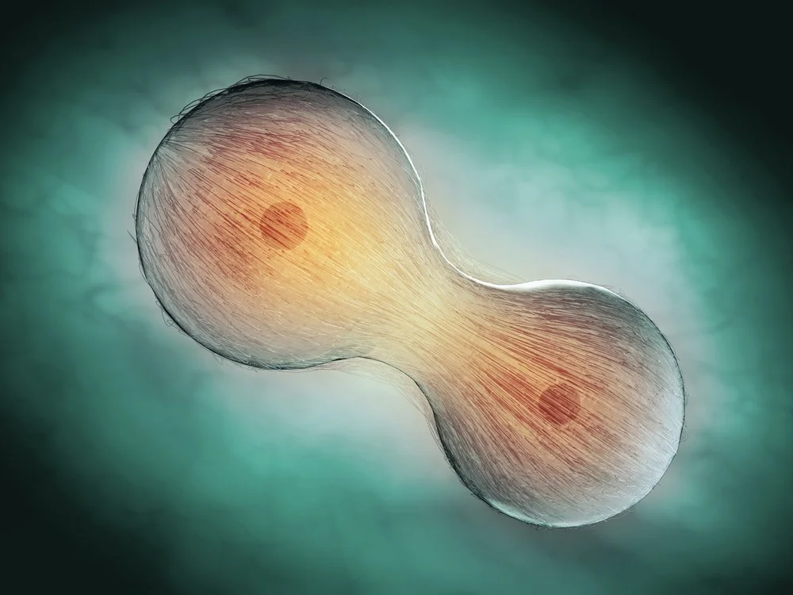
Cell division
Most body cells are capable of division, even in adulthood. Cell division usually leads to production of two identical diploid daughter cells, mitosis and is important in body growth and repair. Production of gametes is different in that the daughter cells have only half the normal chromosome number – 23 instead of 46, i.e. they are haploid. Gametes are produced by a form of cell division called meiosis. DNA replication takes place before mitosis and meiosis.

Slide 4
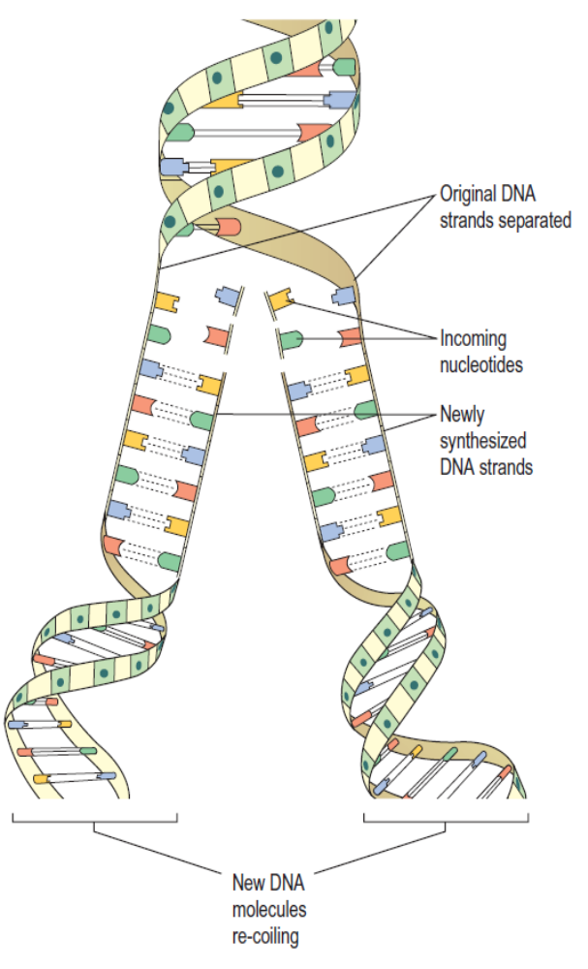
DNA replication
DNA is the only biological molecule capable of selfreplication. Mistakes in copying may lead to production of non-functioning or poorly functional cells, or cells that do not respond to normal cell controls (this could lead to the development of a tumour). Accurate copying of DNA is therefore essential.

Slide 5
The initial step in DNA replication is the unfolding of the double helix and the unzipping of the two strands to expose the bases, as happens in transcription. Both strands of the parent DNA molecule are copied. The enzyme responsible for DNA replication moves along the base sequence on each strand, reading the genetic code and adding the complementary base to the newly forming chain. This means that each strand of opened bases becomes a double strand and the end result is two identical DNA molecules. As each new double strand is formed, other enzymes cause it to twist and coil back into its normal highly folded form.

Slide 6
Mitosis
This is a continuous process involving four distinct stages visible by light microscopy.
Prophase. During this stage the replicated chromatin becomes tightly coiled and easier to see under the microscope. Each of the original 46 chromosomes (called a chromatid at this stage) is paired with its copy in a double chromosome unit. The two chromatids are joined to each other at the centromere. The mitotic apparatus appears; this consists of two centrioles separated by the mitotic spindle, which is formed from microtubules. The centrioles migrate, one to each end of the cell, and the nuclear envelope disappears.
Metaphase. The chromatids align on the centre of the spindle, attached by their centromeres.

Slide 7
Anaphase. The centromeres separate, and one of each pair of sister chromatids (now called chromosomes again) migrates to each end of the spindle as the microtubules that form the mitotic spindle contract.
Telophase. The mitotic spindle disappears, the chromosomes uncoil and the nuclear envelope reforms. Following telophase, cytokinesis occurs: the cytosol, intracellular organelles and plasma membrane split forming two identical daughter cells.

Slide 8
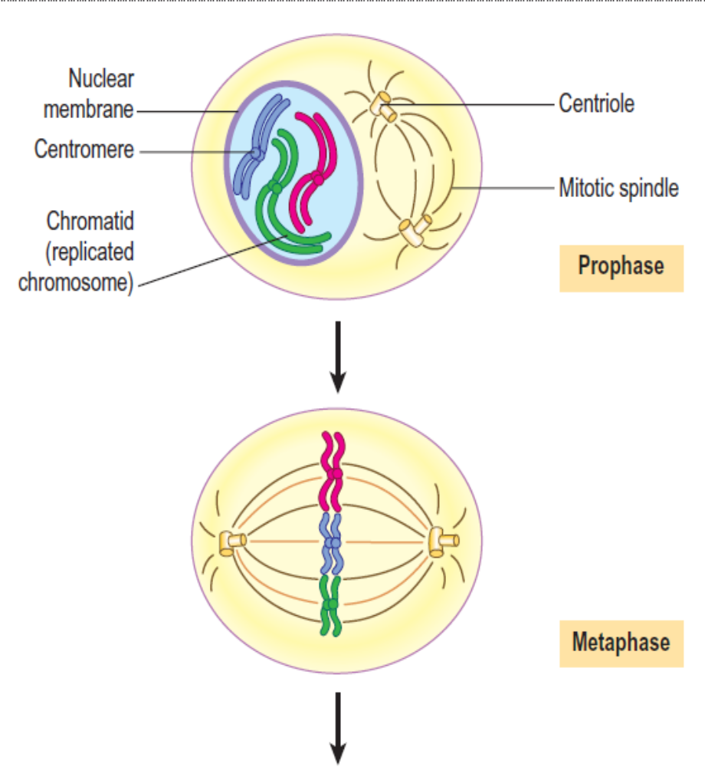
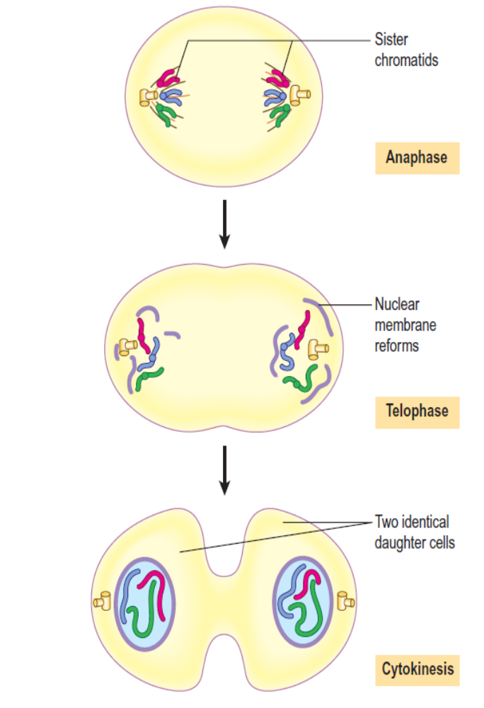
The stages of mitosis

Slide 9
Meiosis
Meiosis is the final step in gamete production. On fertilisation, when the male gamete (sperm cell) and the female gamete (ovum) unite, the resulting zygote is diploid, because each gamete was haploid.
Unlike mitosis, meiosis involves two distinct cell divisions rather than one. Additionally, meiosis produces four daughter cells, not two, all different from the parent cells and from each other. This is the basis of genetic diversity and the uniqueness of each human individual.
First meiotic division
This stage produces two genetically different daughter cells.

Slide 10
DNA replication occurred beforehand, so each pair of chromosomes is now four chromatids, and they gather together into a tight bundle. Because the chromosomes are so tightly associated, it is possible for them to exchange genes. This process is called crossing over, and results in the four chromatids acquiring different combinations of genes. Following crossing over, the pairs of chromosomes then separate in preparation for the first meiotic division, and transfer of maternal and paternal chromosomes to either daughter cell is random. This means that the two daughter cells have an unpredictable assortment of maternal and paternal DNA, giving rise to a huge number of possible combinations of chromosomes in them. This explains why a child inherits a combination of its mother’s and father’s characteristics and why children from the same parents can be very different from one another.

Slide 11
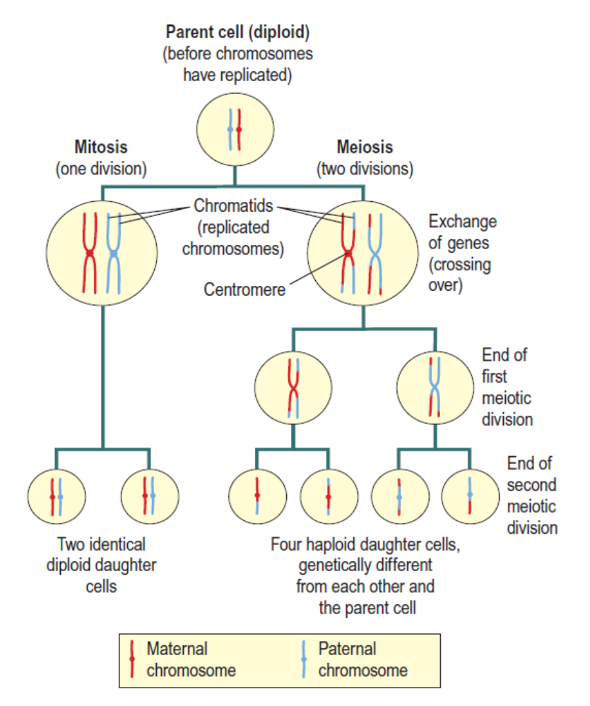
Each pair of chromosomes separates and one travels to each end of the cell, guided by a spindle as in mitosis, producing two genetically unique diploid daughter cells.

Slide 12
Second meiotic division
For a gamete to be produced, the amount of genetic material present in the two daughter cells following the first meiotic division must be halved. This is accomplished by a second division. The centromeres separate and the two sister chromatids travel to opposite ends of the cell, which then divides. Each of the four haploid daughter cells now has only one chromosome from each original pair. Fusion with another gamete creates a zygote (fertilised ovum), a diploid cell which can then go on to grow and develop into a human being by mitosis.

Slide 13
The genetic basis of inheritance
Mixing up of parental genes during meiosis leads to the huge genetic variety of the human race. It is important to understand how genes interact to produce inherited characteristics.
Autosomal inheritance
Each of a pair of homologous chromosomes contains genes for the same traits. For example, the ability to roll one’s tongue is coded for on a single gene. Because one chromosome of each pair is inherited from the father and one from the mother, an individual has two genes controlling the ability to roll the tongue.

Slide 14
Such paired genes are called alleles. Corresponding alleles contain genes concerned with the same trait, but they need not be identical. An individual may have:
• two identical forms of the gene (homozygous)
• two different forms of the gene (heterozygous).
One copy of the tongue-rolling gene may code for the ability to roll the tongue, but the corresponding gene on the other chromosome of the pair may be a different form and code for inability to tongue roll. This simple example involves only two forms of the same gene, but other characteristics are more complex. Eye colour is a diverse trait with a wide range of pigment colours and patterns possible, and is controlled by more than one gene.

Slide 15
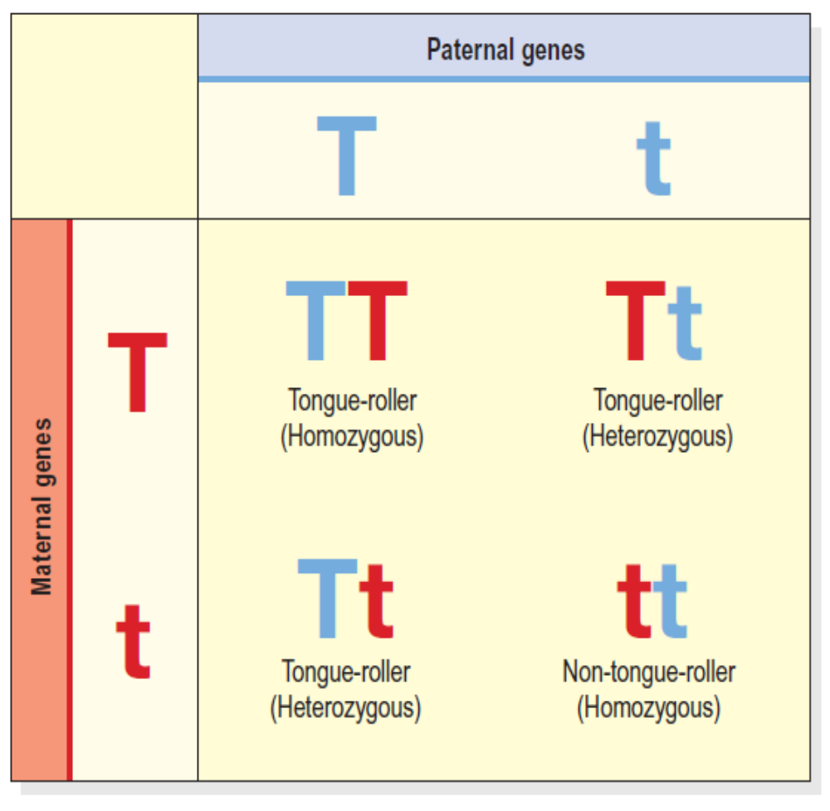
Autosomal inheritance. Examples shows all possible combinations of tongue rolling genes in children of parents heterozygous for the trait.

Slide 16
Should an individual inherit a tongue-rolling gene from one parent, and the non-rolling gene from the other, he will still be able to roll his tongue. This is because the tongue-rolling form of the gene is dominant, and takes priority over the non-rolling gene, which is recessive. Dominant genes are always expressed (active) in preference over recessive genes, and only one copy of a dominant gene is required for that characteristic to be expressed. A recessive gene can only be expressed if it is present on both chromosomes, i.e. individuals unable to tongue-roll have two copies of the recessive, non-rolling gene.
Individuals homozygous for a gene have two identical copies, of either the dominant or the recessive form. Heterozygous individuals have one dominant and one recessive gene.

Slide 17
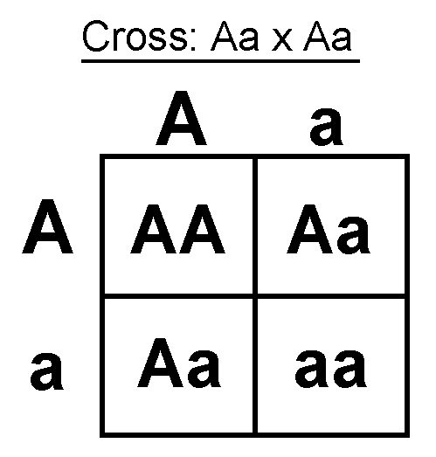
The probability of inheriting either form of a gene depends upon parental make-up. Simple autosomal inheritance can be illustrated using a Punnett square. Slide shows all the possible combinations of the tongue-rolling gene in children whose parents are heterozygous for the trait. Using this example, there is a 3 in 4 (75%) chance that the child of these parents will be a tongue roller (TT or Tt), and only a 1 in 4 chance that they would inherit two recessive genes (tt), making them a non-roller. Prediction of the probability that a baby will be born with an inherited disease, e.g. cystic fibrosis, forms the basis of genetic counselling.

Slide 18
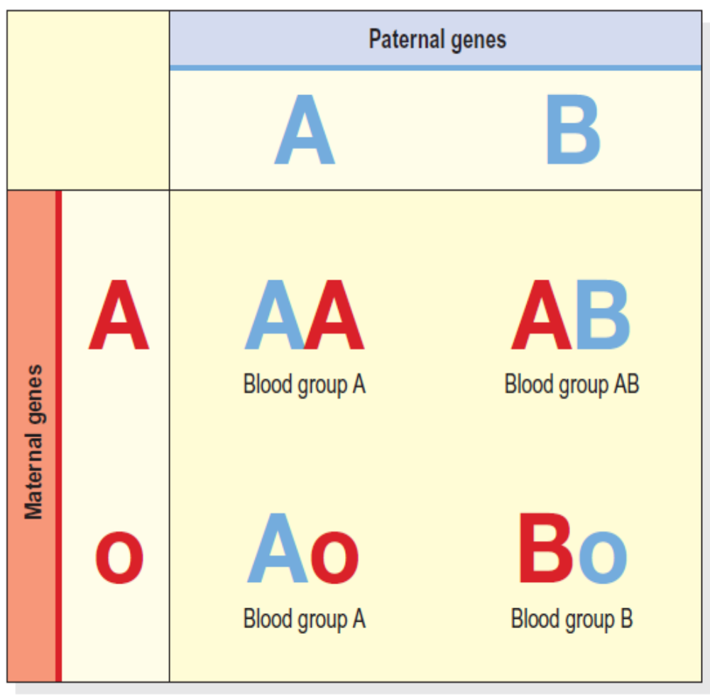
Co-dominant inheritance of ABO blood groups.

Slide 19
Co-dominance
For some traits, there can be more than two alleles that code for it, and more than one allele can be dominant. An example of this is the inheritance of A and B type antigens on the surface of red blood cells, determined clinically as the ABO system of blood grouping. There are three possible alleles here: one allele codes for production of A type antigens (A), one allele codes for production of B type antigens (B) and a third allele codes for no antigen at all (o). An individual may have any combination of two of these three alleles: AA, AB, BB, Ao, Bo, or oo. Both A and B are dominant, and both express themselves wherever they are present.

Slide 20
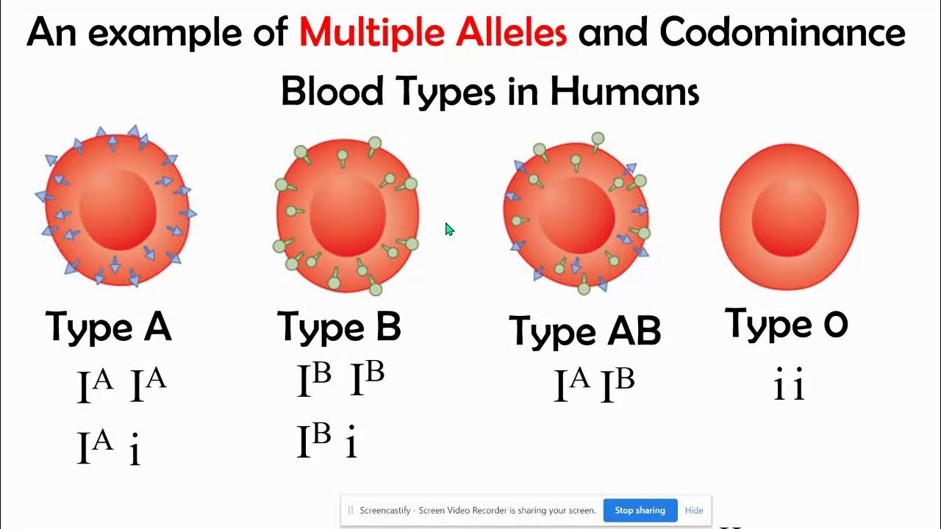
This is called co-dominance. O is recessive, and so only expresses itself in a homozygous recessive genotype. This means that individuals with an oo genotype have neither A nor B antigens on their red cell surface and are blood group O. An individual with genotype AB has both A and B and is blood group AB. An individual with genotype Ao or AA has only A type antigens and is blood group A; someone with genotype Bo or BB has only B type antigens and is blood group B.

Slide 21
Sex-linked inheritance
We know that the Y chromosome is much smaller than the X chromosome. It is not surprising then to find that the Y chromosome carries only 86 genes compared with the X chromosome’s 2000, and the vast majority of genes on the X-chromosome are not matched on the Y. This means that a male has only one copy of most of the genes on his sex chromosomes. Traits coded for on the section of the X chromosome that has no corresponding material on the Y are said to be sex linked. The gene that codes for normal colour vision is one example, and is therefore carried on X chromosomes only. It is the dominant form of the gene. There is a rare, recessive form of this gene, which is faulty and codes for red–green colour blindness.

Slide 22
If a female inherits a faulty copy of the gene, she is statistically likely to have a normal gene on her other X chromosome, giving normal colour vision. A female carrying the colour blindness gene, even though she is not colour blind, may pass the faulty gene on to her children and is said to be a carrier. If the gene is abnormal in a male, he will be colour blind because, having only one X-chromosome, he has only one copy of the gene. Inheritance of colour blindness is shown in next slide, This illustrates the possible genetic combinations of the children of a carrier mother (one normal gene and one faulty gene) and a normal father (one normal gene).
There is a 50% chance of a son being colour blind, a 50% chance of a son having normal vision, a 50% chance of a daughter being a carrier (with normal vision herself) and a 50% chance of a daughter being normal.

Slide 23
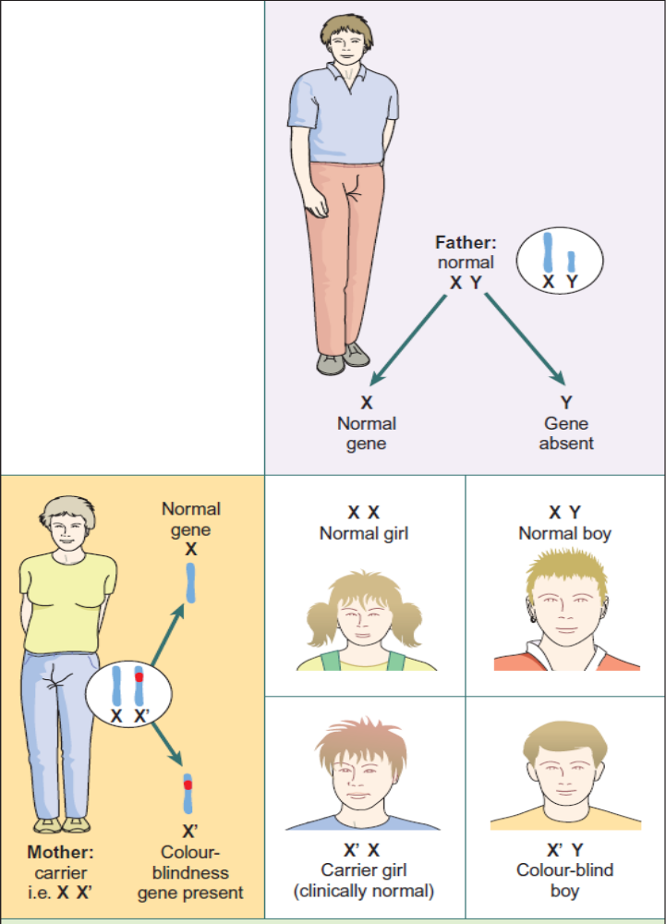
Inheritance of sex-linked color blindness gene between generations.

Slide 24
Ageing and DNA
Cumulative exposure over a lifetime to potential mutagens as well as a diminishing ability to repair DNA means the cell’s genome gradually accumulates mutations, which can lead to diminished function and increased risk of disease, e.g. cancer. Mitochondrial DNA is more prone to mutations than nuclear DNA and as it ages and develops ‘wear and tear’ damage, it causes progressive impairment of cell function.
Cell senescence (ageing). The number of times a cell can divide is somewhere between 50 and 60 divisions. One important factor in this is thought to relate to the effects of ageing on telomerase function. Telomerase is the enzyme that repairs the telomeres (chromosome tips) following DNA replication. It declines in function with age.

Slide 25
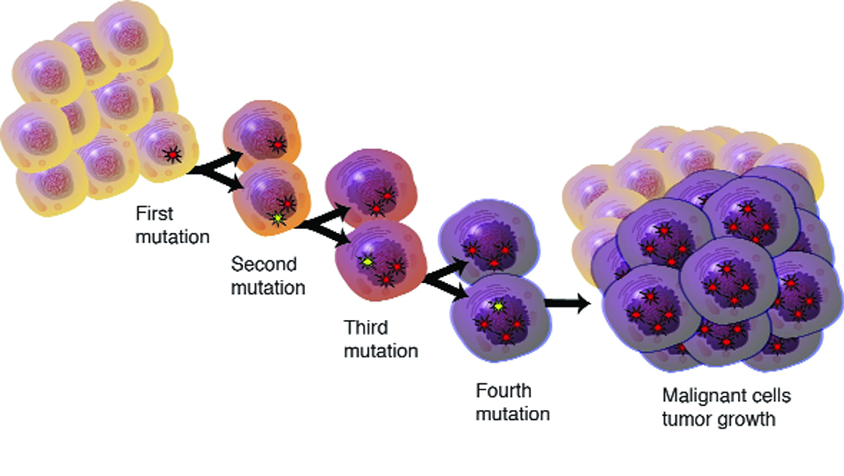
Genetic basis of disease
Cancer
Cancer (malignant growth of new tissue) is caused by mutation of cellular DNA, causing its growth pattern to become disorganised and uncontrolled.
Inherited disease
Next slide lists a number of diseases with an inherited component :

Slide 26
Some disorders with genetic component
Single gene disorder | More complex inheritance
Phenylketonuria | More than one gene likely to involved,
Duchenne muscular dystrophy | Lifestyle and other factors involved:
Huntington disease | Asthma
Haemophilia | Cleft lip
Achondroplasia | Hypertension
Some cancers: | Atheroma
Breast, Ovarian, Bowel cancers | Some cancers: breast, gastric
Myotonic dystrophy | Type I and II, diabetes mellitus
Cystic fibrosis | Epilepsy
Polycystic kidney disease | Schizophrenia
 | Neural tube defects; spina bifida

Slide 27
Gene mutations
Many diseases, such as cystic fibrosis and haemophilia, are passed directly from parent to child via a faulty gene. Many of these genes have been located by mapping of the human genome, e.g. the gene for cystic fibrosis is carried on chromosome 7. Other diseases, e.g. asthma, some cancers and cardiovascular disease, have a genetic component (run in the family). In these cases, a single faulty gene has not been identified, and inheritance is not as predictable as when a single gene is responsible. The likelihood of an individual developing the disease depends not only on their genetic make-up, but also on the influence of other factors, such as lifestyle and environment.

Slide 28
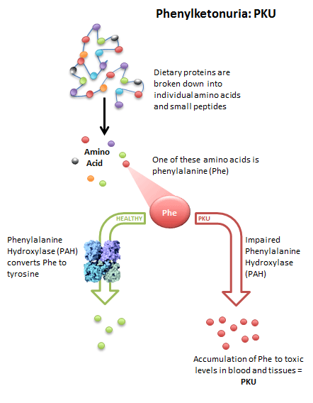
Phenylketonuria
In this disorder, an example of an inborn error of metabolism, the gene responsible for producing the enzyme phenylalanine hydroxylase is faulty, and the enzyme is absent. This enzyme normally converts phenylalanine to tyrosine in the liver, but in its absence phenylalanine accumulates in the liver and overflows into the blood. In high quantities, phenylalanine is toxic to the central nervous system and, if untreated, results in brain damage and mental retardation within a few months. Because there are low levels of tyrosine, depigmentation occurs and affected children are fair skinned and blonde.

Slide 29
Mitochondrial abnormalities
Mitochondrial DNA contains only 37 genes but defects in these genes can cause inherited disorders with a very wide range of potentially fatal signs and symptoms, most commonly involving the CNS and skeletal or cardiac muscle. Spontaneous mutations in this DNA can also occur in maturity, leading to onset of disease in adults. There is evidence that mitochondrial mutations may be associated with some forms of important diseases, e.g. diabetes mellitus, Parkinson disease and Alzheimer disease.

Slide 30
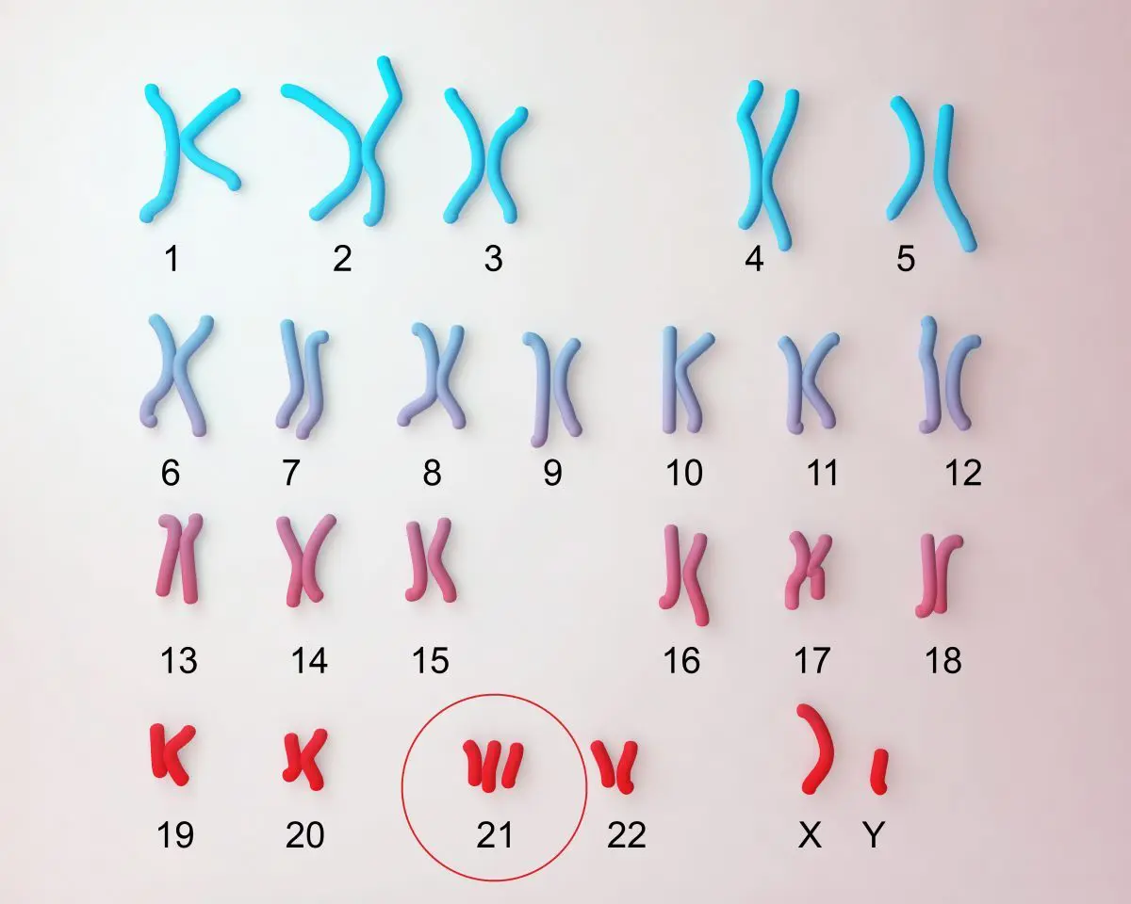
Chromosomal abnormalities
Sometimes a fault during meiosis produces a gamete carrying abnormal chromosomes – too many, too few, abnormally shaped, or with segments missing. Often, these aberrations are lethal and a pregnancy involving such a gamete miscarries in the early stages. Non-lethal conditions include Down syndrome and cri-du-chat syndrome.

Slide 31
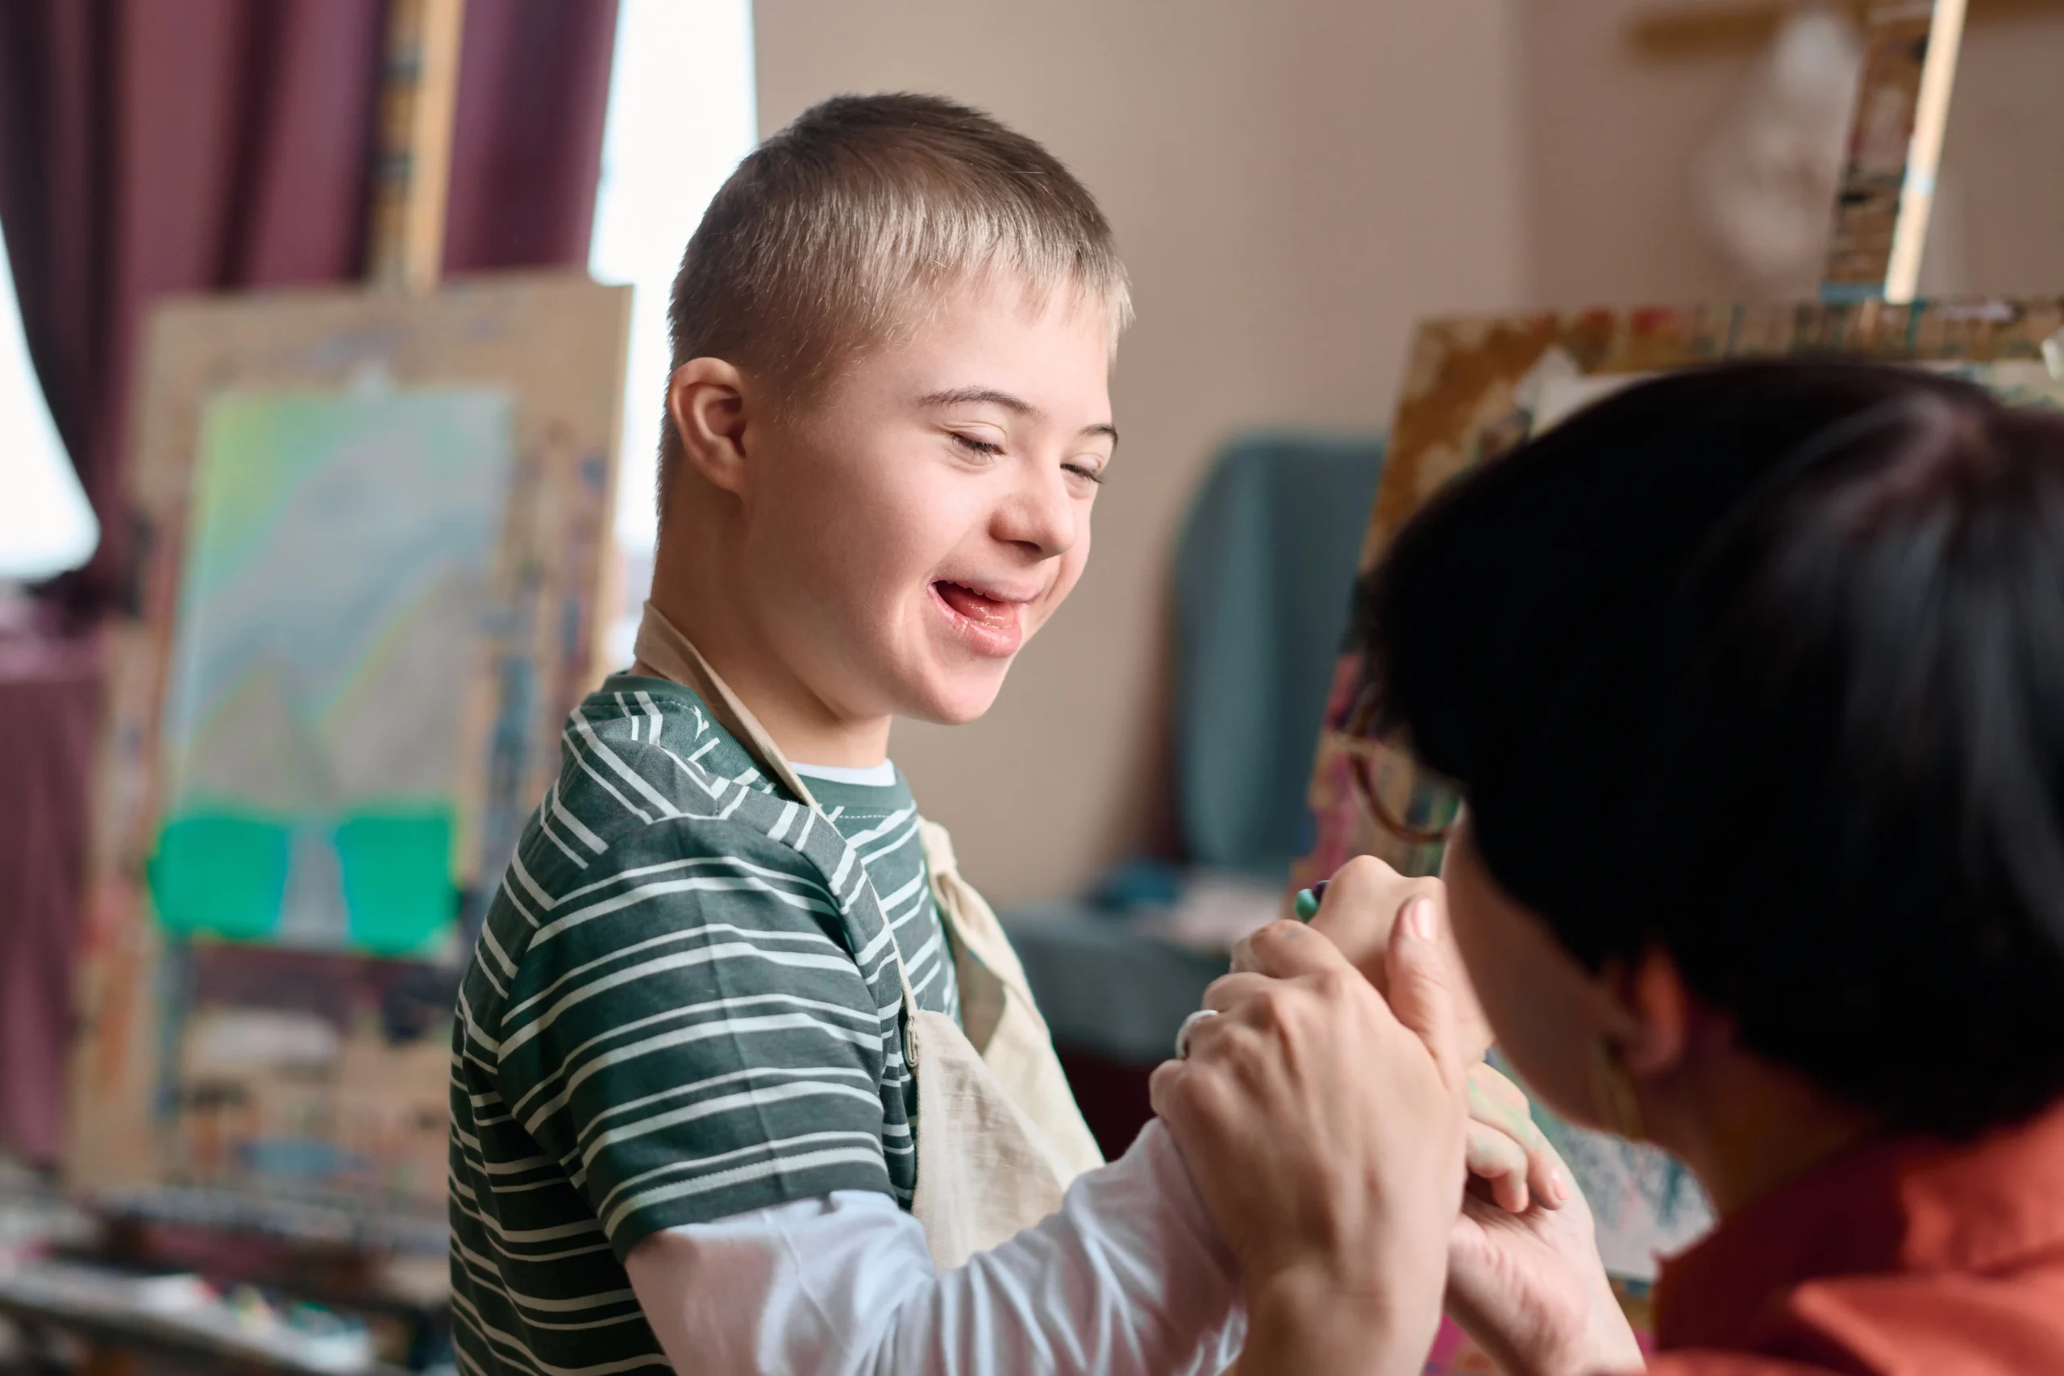
Down syndrome
In this disorder, there are three copies of chromosome 21 (trisomy 21), meaning that an extra chromosome is present, caused by failure of chromosomes to separate normally during meiosis. People with Down syndrome are usually short of stature, with pronounced eyelid folds and flat, round faces. The tongue may be too large for the mouth and habitually protrudes. Learning disability is present, ranging from mild to severe. Life expectancy is shorter than normal, with a higher than average incidence of cardiovascular and respiratory disease, and a high incidence of early dementia. Down syndrome is associated with increasing maternal age, especially over 35 years.

Slide 32
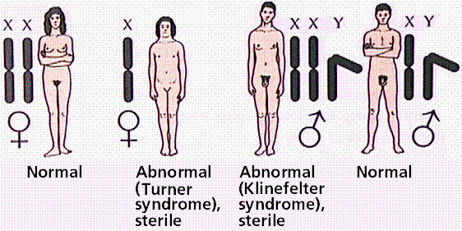
Abnormalities of the sex chromosomes
If the sex chromosomes fail to separate normally during meiosis, the daughter cells will have an incorrect number, either too many or too few. A child born with such an abnormality will not follow normal sexual development without treatment, and may have additional problems such as learning disability.

Slide 33
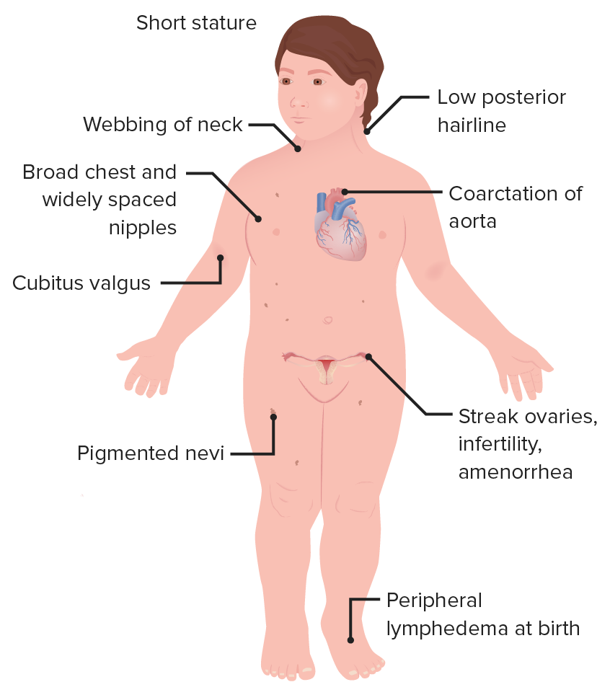
Turner syndrome. This is usually associated with having only one sex chromosome, an X, as well as 22 normal pairs of autosomes. The karyotype is therefore usually XO, and affected individuals are female. They have female external genitalia and ovaries, but are infertile because the ovaries fail to develop during fetal life, and secondary sexual characteristics do not develop at puberty unless oestrogen treatment is given. Other features include short stature and coarctation of the aorta (in 15%). Intelligence is usually normal.

Slide 34
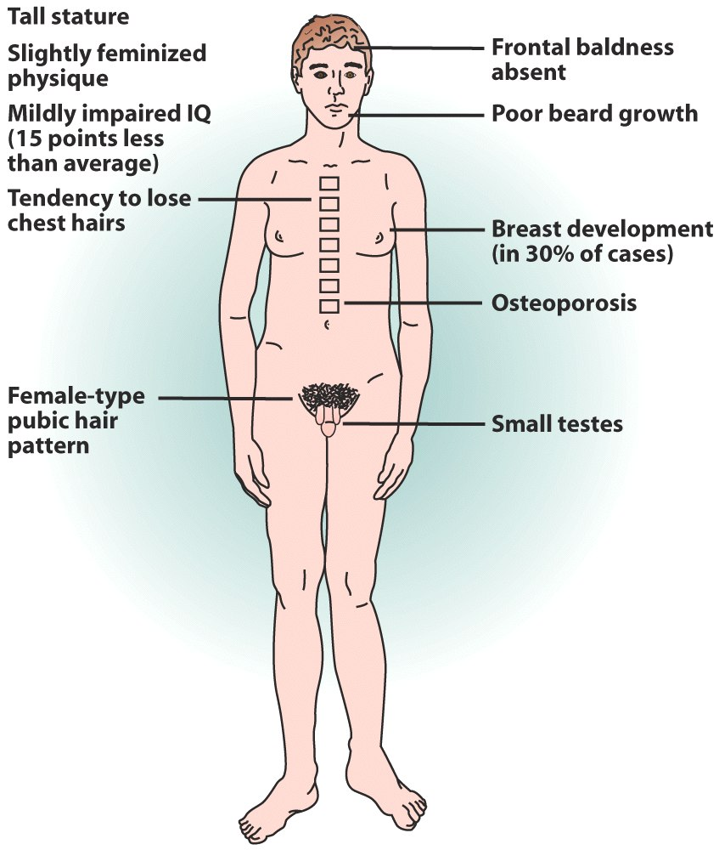
Klinefelter syndrome. The karyotype in this condition is XXY, so affected individuals are male, with 47 chromosomes instead of 46. This condition is commoner than Turner syndrome and is associated with a greater than average height and mild learning disability. The genitalia are male but the testes are underdeveloped and affected individuals are infertile. At puberty, development of feminine characteristics such as enlarged breasts (gynaecomastia) and rounded hips is common, and there is no development of male secondary sexual characteristics unless testosterone treatment is given.

