Slide 1
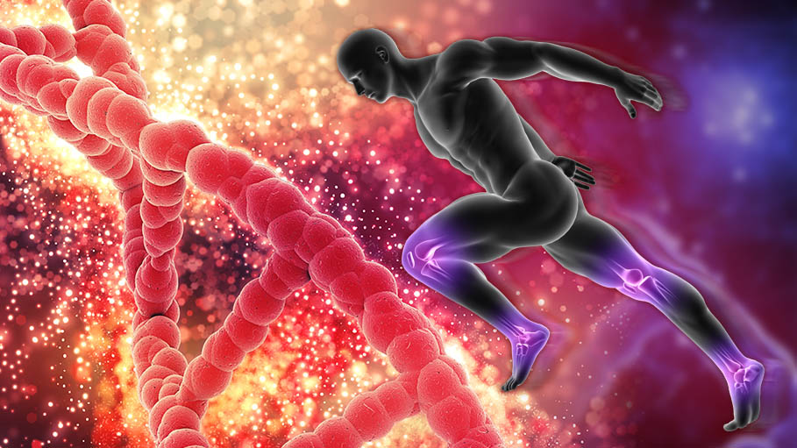
Physiology IV

Slide 2
Protection & Survival
Introduction to genetic

Slide 3
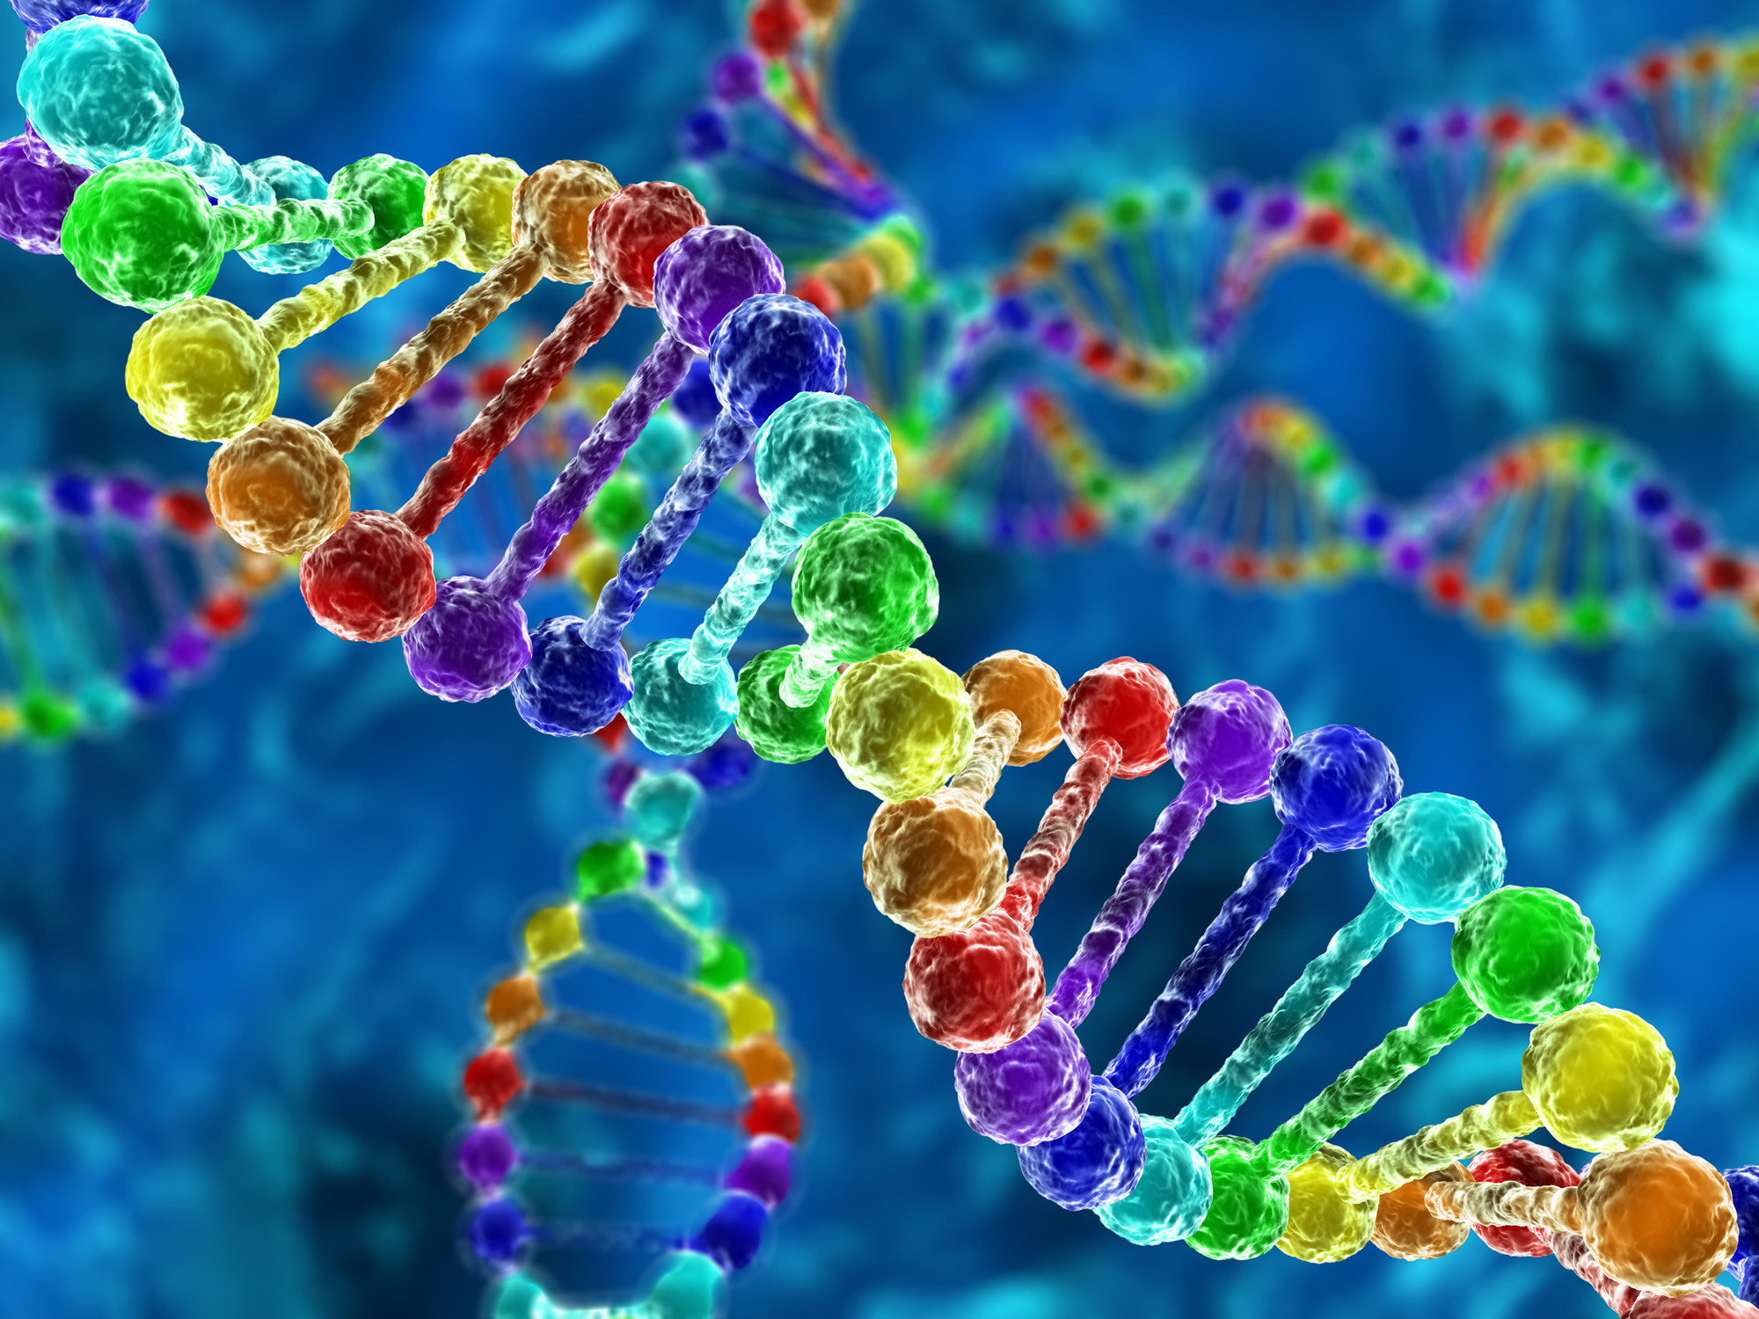
All living organisms, including human beings, need to reproduce, so that at the end of their life span they have produced at least one, often several, other individuals to replace themselves. This ensures the continuation of their species. Offspring inherit from their parents a copy of all information needed to develop into a functioning organism; this information is carried as deoxyribonucleic acid (DNA), mainly within the cell nucleus. DNA is organised into functional units called genes, which themselves are part of much bigger structures, the chromosomes. Collectively, all the genetic material in a cell is called its genome.

Slide 4
Genetics is the study of genes, and advancing knowledge in this area has a profound effect on many aspects of daily life, e.g. for genetic counselling in families carrying inherited diseases and the production of human insulin from genetically engineered micro-organisms.
The Human Genome project, an international collaboration, was initiated in 1990. Its aim was to identify and sequence every gene on every chromosome, and to be able to draw a map of each chromosome, showing the position of all its genes. It has yielded a great deal of important information regarding human genetic disorders.

Slide 5
Chromosomes, genes and DNA
Chromosomes
Nearly every body cell contains, within its nucleus, an identical copy of the entire complement of the individual’s genetic material. Two important exceptions are red blood cells (which have no nucleus) and the gametes or sex cells. In a resting cell, the chromatin is diffuse and hard to see under the microscope, but when the cell prepares to divide, it is collected into highly visible, compact, sausage-shaped structures called chromosomes. Each chromosome is one of a pair, one inherited from the mother and one from the father, so the human cell has 46 chromosomes that can be arranged as 23 pairs.

Slide 6
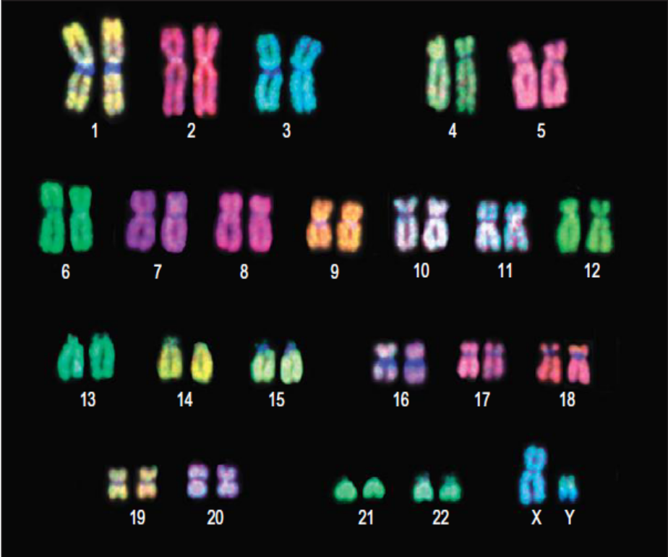
A cell with 23 pairs of chromosomes is termed diploid. Gametes (spermatozoa and ova) with only half of the normal complement, i.e. 23 chromosomes instead of 46, are described as haploid. Chromosomes belonging to the same pair are called homologous chromosomes. The complete set of chromosomes from a cell is its karyotype.

Slide 7
Each pair of chromosomes is numbered, the largest pair being no. 1. The first 22 pairs are collectively known as autosomes, and the chromosomes of each pair contain the same amount of genetic material. The chromosomes of pair 23 are called the sex chromosomes because they determine the individual’s gender. Unlike autosomes, these two chromosomes are not necessarily the same size; the Y chromosome is much shorter than the X and is carried only by males. A child inheriting two X chromosomes (XX), one from each parent, is female, and a child inheriting an X from his mother and a Y from his father (XY) is male.

Slide 8
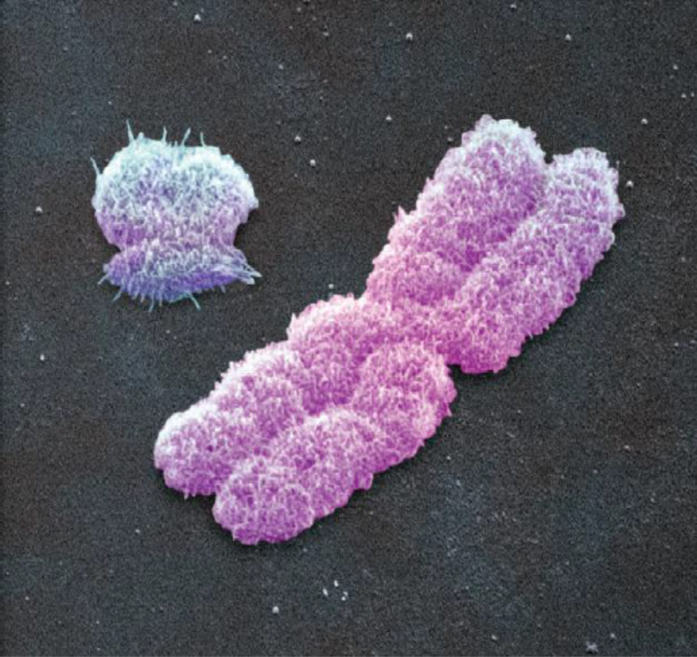
Each end of the chromosome is capped with a length of DNA called a telomere, which seals the chromosome and is structurally essential. During replication, the telomere is shortened, which would damage the chromosome, and so it is repaired with an enzyme called telomerase. Reduced telomerase activity with age is related to cell senescence.

Slide 9
Genes
Along the length of the chromosomes are the genes. Each gene contains information in code that allows the cell to make (almost always) a specific protein, the so-called gene product. Each gene codes for one specific protein, and research puts the number of genes in the human genome at between 25 000 and 30 000.
Genes normally exist in pairs, because the gene on one chromosome is matched at the equivalent site (locus) on the other chromosome of the pair.

Slide 10
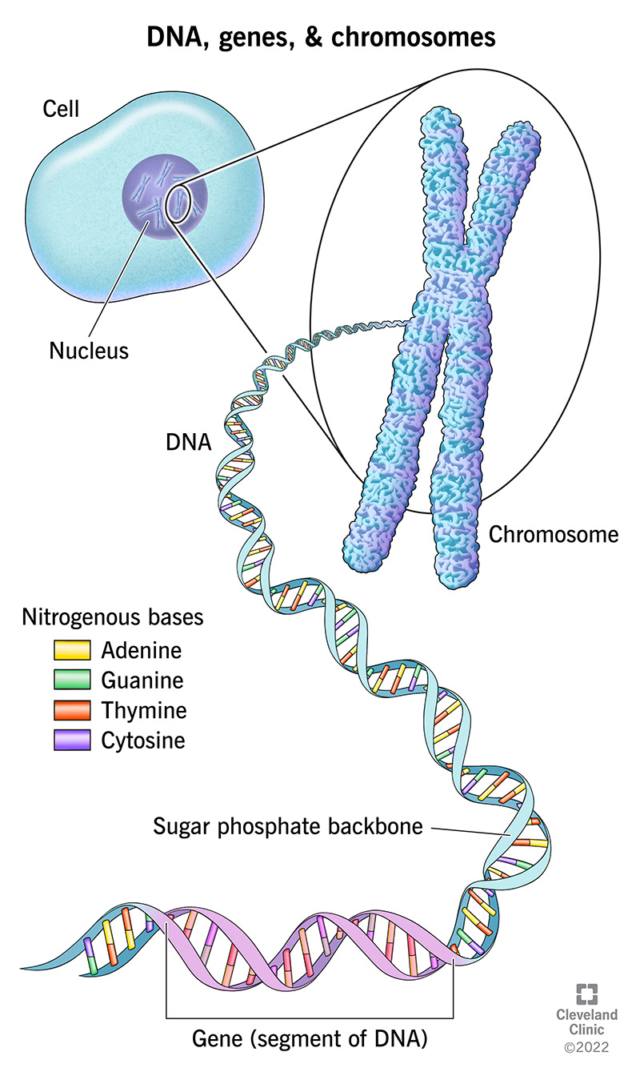
DNA
Genes are composed mainly of very long strands of DNA; the total length of DNA in each cell is about a metre. Because this is packaged into chromosomes, which are micrometres (10−6 m) long, this means that the DNA must be tightly wrapped up to condense it into such a small space.
DNA is a double-stranded molecule, made up of two chains of nucleotides. Nucleotides consist of three subunits:

Slide 11
• a sugar
• a phosphate group
• a base.
The DNA molecule is sometimes likened to a twisted ladder, with the uprights formed by alternating chains of sugar and phosphate units (Fig. 17.3). In DNA, the sugar is deoxyribose, thus DNA. The bases are linked to the sugars, and each base binds to another base on the other sugar/phosphate chain, forming the rungs of the ladder. The two chains are twisted around one another, giving a double helix (twisted ladder) arrangement. The double helix itself is further twisted and wrapped in a highly organised way around structural proteins called histones, which are important in maintaining the heavily coiled three-dimensional shape of the DNA. The term given to the DNA–histone material is chromatin. The chromatin is supercoiled and packaged into the chromosomes shortly before the cell divides.

Slide 12
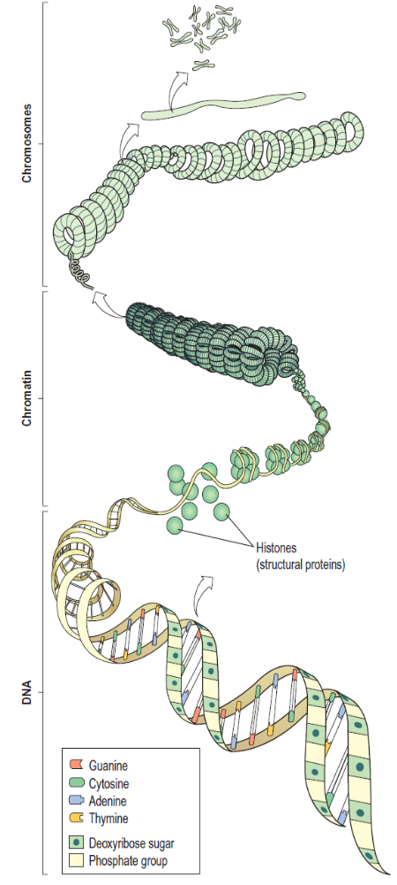
The genetic code
DNA carries a huge amount of information that determines all biological activities of an organism, and which is transmitted from one generation to the next. The key to how this information is kept is found in the bases within DNA. There are four bases:
• adenine (A)
• guanine (G)
• thymine (T)
• cytosine (C).

Slide 13
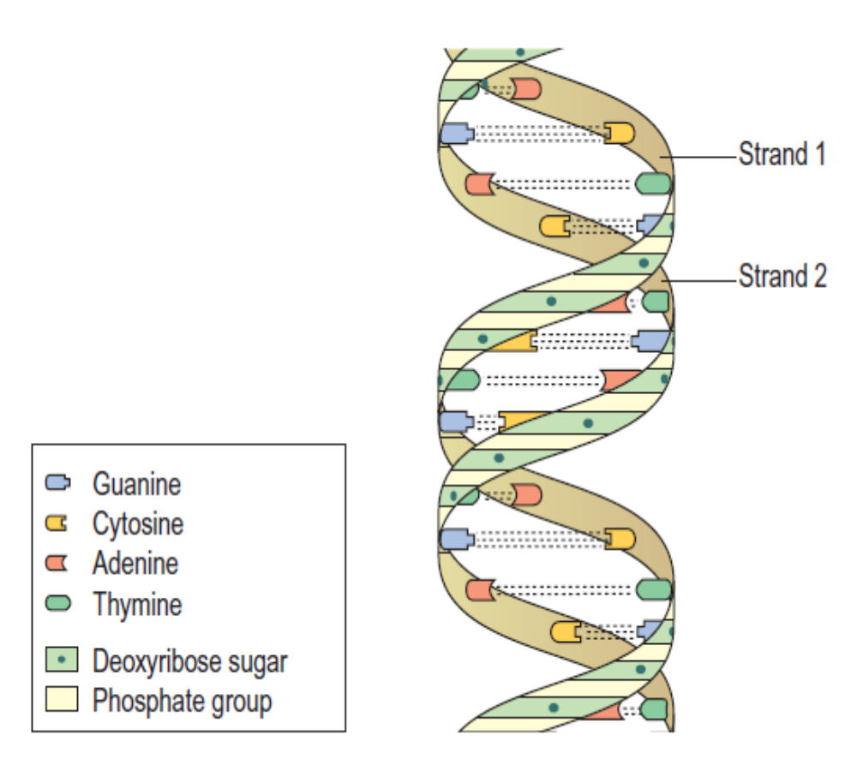
They are arranged in a precise order along the DNA molecule, making a base code that can be read when protein synthesis is required. Each base along one strand of DNA pairs with a base on the other strand in a precise and predictable way. This is known as complementary base pairing. Adenine always pairs with thymine (and vice versa), and cytosine and guanine always go together.
The bases on opposite strands run down the middle of the helix and bind to one another with hydrogen bonds.

Slide 14
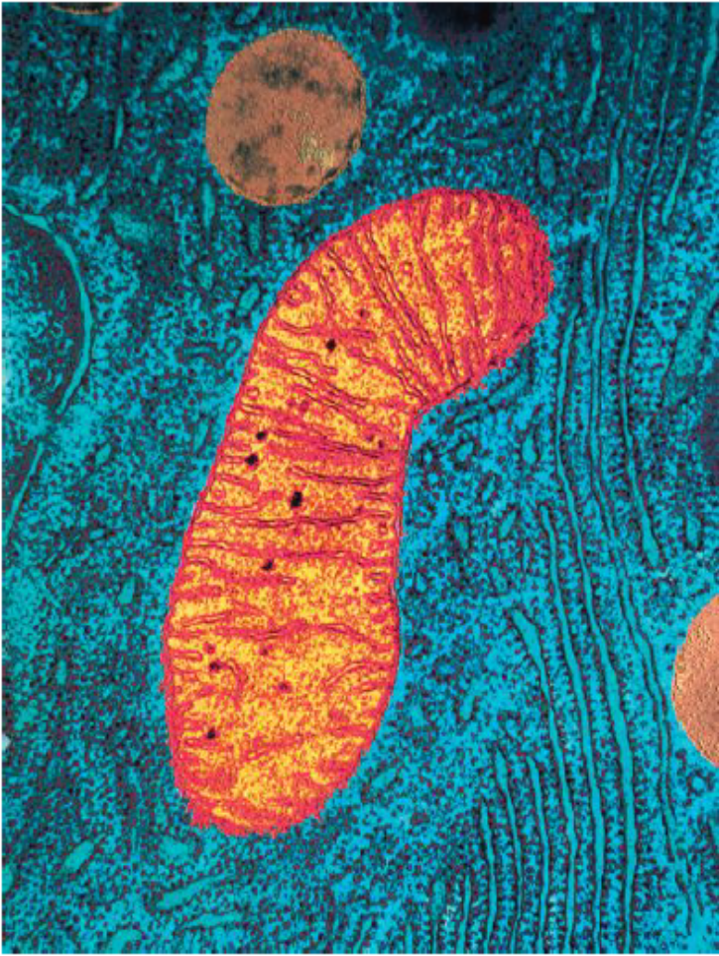
Mitochondrial DNA
Each body cell has, on average, 5000 mitochondria that hold a quantity of DNA (mitochondrial DNA), which codes, for example, for enzymes important in energy production. This DNA is passed from one generation to another via the ovum, so the offspring’s complement of mitochondrial DNA is inherited from the mother. Certain rare inherited disorders that arise from faulty mitochondrial DNA are therefore passed through generations via the maternal line.

Slide 15
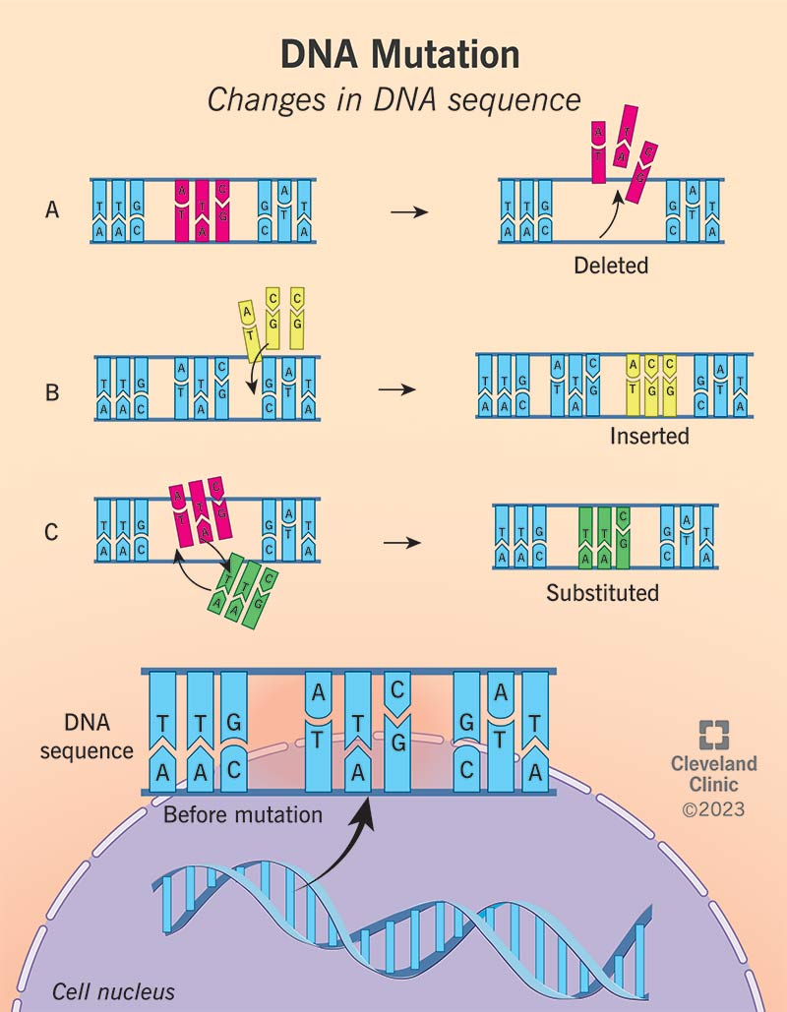
Mutation
Mutation means an inheritable alteration in the normal genetic make-up of a cell. Most mutations occur spontaneously, because of the countless millions of DNA replications and cell divisions that occur normally throughout life. Others may be caused by external factors, such as X-rays, ultraviolet rays or exposure to certain chemicals. Any factor capable of mutating DNA is called a mutagen. Most mutations are immediately repaired by an army of enzymes present in the cell nucleus, and therefore cause no permanent problems.

Slide 16
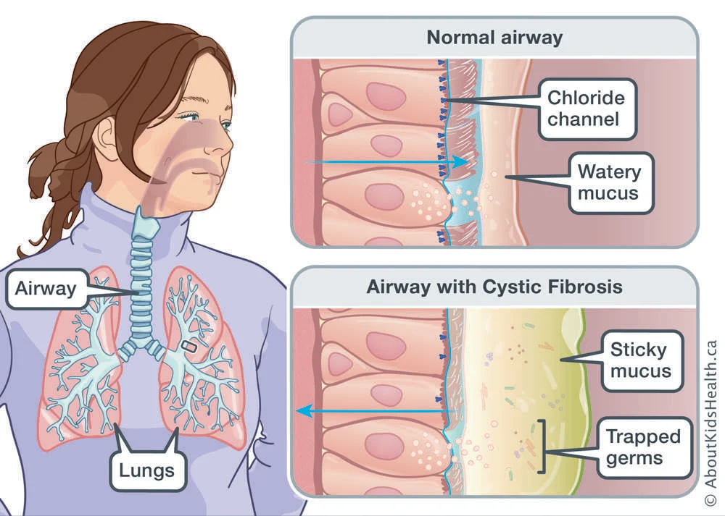
Sometimes the mutation is lethal, because it disrupts some essential cellular function, causing cell death and the mutation is destroyed along with the cell. Often, the mutated cell is detected by immune cells and destroyed because it is abnormal. Other mutations do not kill the cell but alter its function in some way that may cause disease, e.g. in cancer. A persistent mutation in the genome that has not led to cell death can be passed from parent to child and may cause inherited disease, e.g. phenylketonuria or cystic fibrosis.

Slide 17
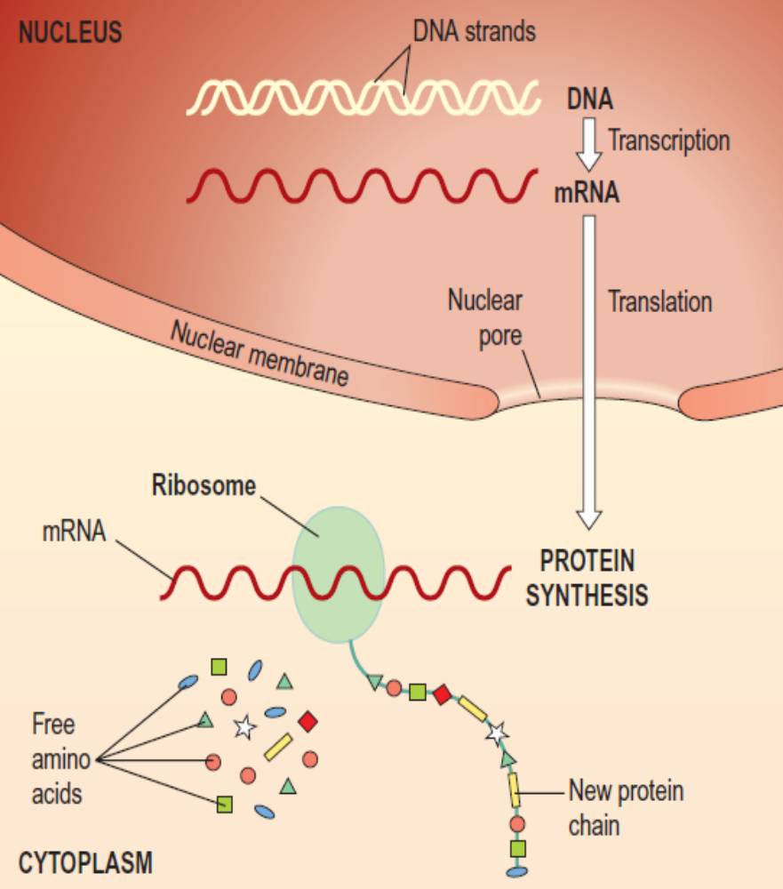
Protein synthesis
DNA holds the cell’s essential biological information, written within the base code in the centre of the double helix. The products of this information are almost always proteins. Proteins are essential to all aspects of body function, forming the major structural elements of the body as well as the enzymes essential for all biochemical processes within it.

Slide 18
The building blocks of human proteins are about 20 different amino acids. As the cell’s DNA is too big to leave the nucleus, an intermediary molecule is needed to carry the genetic instructions from the nucleus to the cytoplasm, where proteins are made. This is called messenger (m)RNA.
Messenger ribonucleic acid (mRNA)
mRNA is a single-stranded chain of nucleotides synthesized in the nucleus from the appropriate gene, whenever the cell requires to make the protein for which that gene codes. There are three main differences between the structures of RNA and DNA:
• it is single instead of double stranded
• it contains the sugar ribose instead of deoxyribose
• it uses the base uracil instead of thymine.

Slide 19
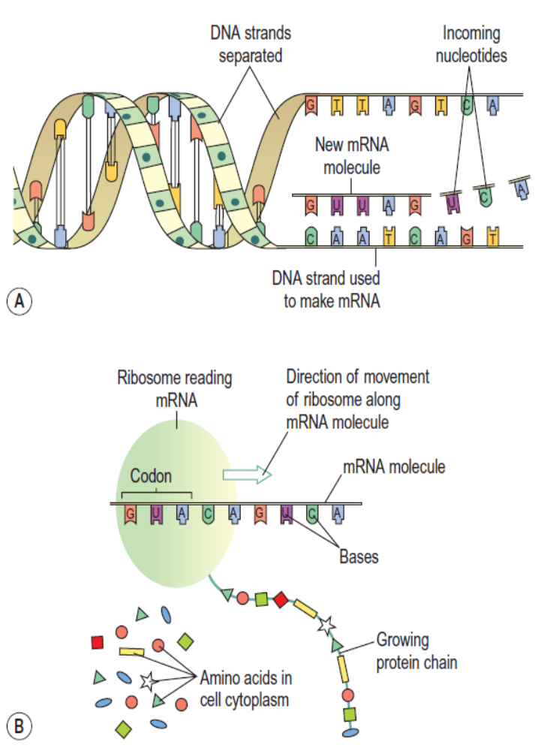
Using the DNA as a template, a piece of mRNA is made from the gene to be used. This process is called transcription. The mRNA then leaves the nucleus through the nuclear pores and carries its information to the ribosomes in the cytoplasm.

Slide 20
Transcription
Because the code is buried within the DNA molecule, the first step is to open up the helix to expose the bases. Only the gene to be transcribed is opened; the remainder of the chromosome remains coiled. Opening up the helix exposes both base strands, but the enzyme that makes the mRNA uses only one of them, so the mRNA molecule is single, not double stranded. As the enzyme moves along the opened DNA strand, reading its code, it adds the complementary base to the mRNA. Therefore, if the DNA base is cytosine, guanine is added to the mRNA molecule (and vice versa); if it is thymine, adenine is added; if it is adenine, uracil is added (remember there is no thymine in RNA, but uracil instead). When the enzyme gets to a ‘stop’ signal, it terminates synthesis of the mRNA molecule, and the mRNA is released. The DNA is zipped up again by other enzymes, and the mRNA then leaves the nucleus.

Slide 21
Translation
Translation is synthesis of the final protein using the information carried on mRNA. It takes place on free ribosomes in the cytoplasm and those attached to rough endoplasmic reticulum. First, the mRNA attaches to the ribosome. The ribosome then ‘reads’ the base sequence of the mRNA.
Because proteins are built from up to 20 different amino acids, it is not possible to use the four bases individually in a simple one-to-one code. To give enough options, the base code in RNA is read in triplets, giving a possible 64 base combinations, which allows a coded instruction for each amino acid as well as other codes, e.g. stop and start instructions. Each of these specific triplet sequences is called a codon; for example, the base sequence ACA (adenine, cytosine, adenine) codes for the amino acid cysteine.

Slide 22
The first codon is a start codon, which initiates protein synthesis. The ribosome slides along the mRNA, reading the codons and adding the appropriate amino acids to the growing protein molecule as it goes. The ribosome continues assembling the new protein molecule until it arrives at a stop codon, at which point it terminates synthesis and releases the new protein. Some new proteins are used within the cell itself, and others are exported, e.g. insulin synthesised by pancreatic β-islet cells is released into the bloodstream.

Slide 23
Gene expression
Although all nucleated cells (except gametes) have an identical set of genes, each cell type uses only those genes related directly to its own particular function. For example, the only cell type containing haemoglobin is the red blood cell, although all body cells carry the haemoglobin gene. This selective gene expression is controlled by various regulatory substances, and the genes not needed by the cell are kept switched off.

Slide 24
