Slide 1

Anterior compartment syndrome
Orthopedic Massage

Slide 2
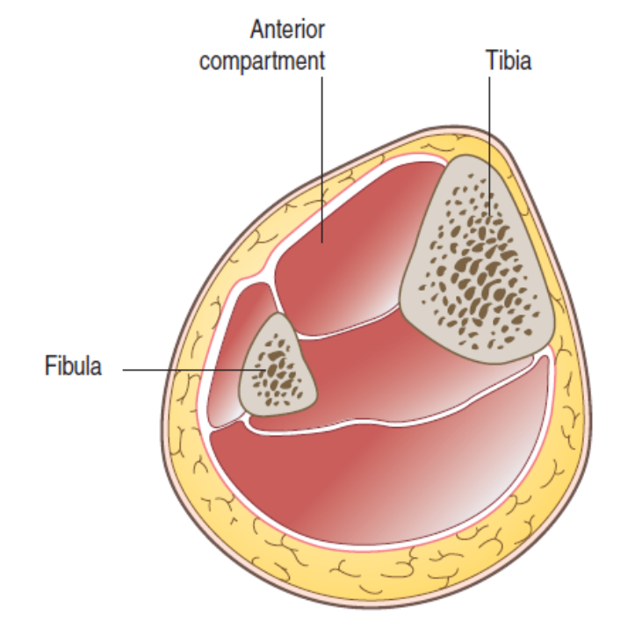
Description
The lower leg is composed of four separate compartments: the anterior, lateral, superficial posterior and deep posterior. Each compartment is separated from the others by strong fascial walls. The tibia and fibula also contribute part of the unyielding borders for these fascial compartments. A compartment syndrome can occur in any of the limbs, but usually it develops in the lower leg, and especially in the anterior compartment.

Slide 3
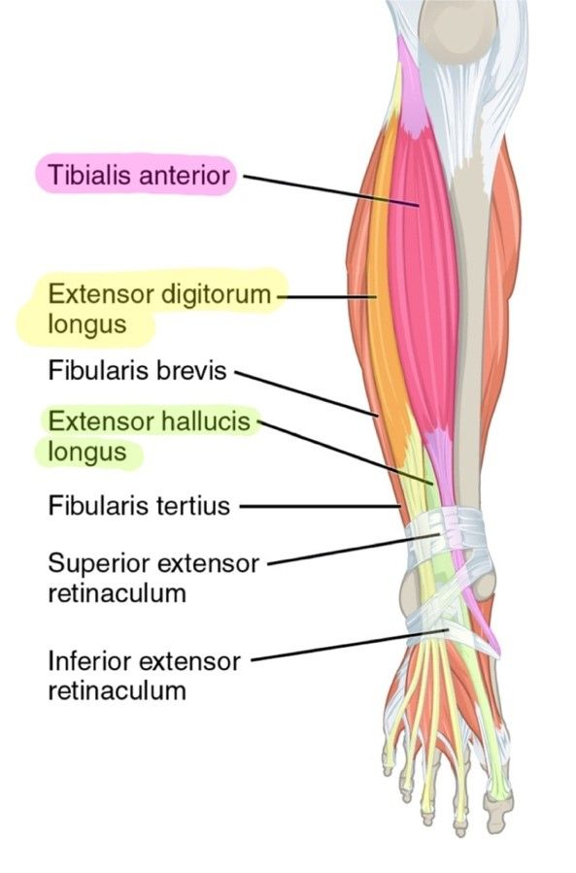
Anterior compartment syndrome results from swelling of the muscles within the compartment. Because the compartment walls are strong and unyielding, there is no extra room for the expanding muscles. As a result, there is a pressure increase inside the compartment, and the muscles press on other structures inside the compartment. During anterior compartment syndrome, there may be as much as a 20% increase in muscle mass.

Slide 4
The anterior compartment of the lower leg contains three muscles: tibialis anterior, extensor digitorum longus, and extensor hallucis longus. It also contains the tibial artery and vein, as well as the deep peroneal nerve. Increased pressure inside the compartment can impair these structures. Pressure on the vascular structures can cause ischemia, possible color changes in the limb, and sensations of coldness in the extremity or the feet. Lack of circulation is a serious concern in compartment syndromes. Prolonged ischemia from compression of the vascular structures can lead to tissue necrosis. In severe cases, the necrosis can be damaging enough to warrant amputation of the limb.

Slide 5
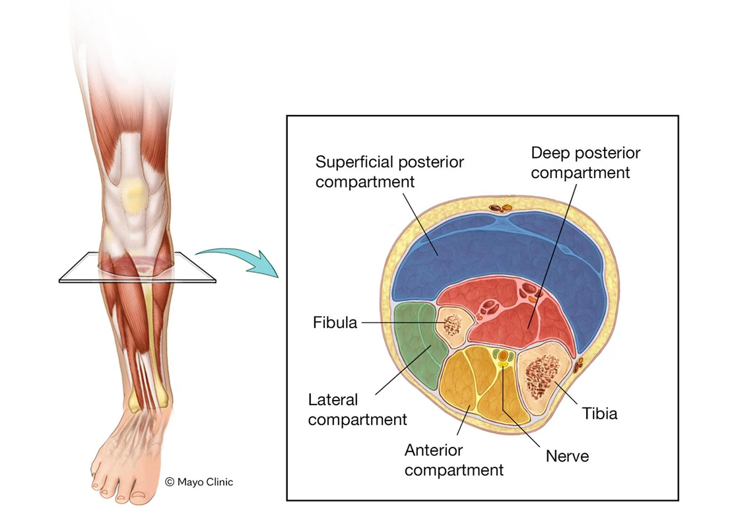
Compression injury to the nerves that run through the compartment is also a primary concern. Symptoms of numbness, tingling, or loss of dorsiflexor function result from nerve compression. Sharp or shooting pain sensations on the dorsal surface of the foot may also be reported. Compression of the deep peroneal nerve in the anterior compartment can also occur from pressure on the nerve against the head of the fibula.

Slide 6
The pain sensations of anterior compartment syndrome are often mistaken for shin splints. However, there are some distinct differences between the conditions. For example, shin splints rarely cause neurological sensations, as the deep peroneal nerve is not affected in shin splints. Treatment for these two problems is quite different, and an untreated compartment syndrome can be a serious condition. The primary indicator of a compartment syndrome is pain that is out of proportion to what is likely for shin splints.
Anterior compartment syndrome occurs as either an acute or chronic condition. If it is an acute condition, it usually results from a direct blow to the anterior shin. However, it can occur along with a fracture or other acute trauma, such as a muscle strain. Several authors have reported acute compartment syndromes occurring directly after severe muscle strains to the muscles in the lower leg.

Slide 7
As a result of the acute trauma, the muscles swell, become ischemic, and increase pressure levels within the compartment. It is not mandatory that an individual have a direct blow to cause the acute compartment syndrome. An excessive bout of activity can also cause the acute compartment syndrome.
The chronic compartment syndrome is much more common. This condition is also called exertional compartment syndrome (ECS), because the primary cause is repetitive exertion and overuse of the lower leg muscles. It results from exercise on an unyielding surface, improper footwear, or activity that is out of proportion to what the individual has conditioned for.

Slide 8
A chronic compartment syndrome can develop into an acute compartment syndrome if the individual engages in a greater than normal level of activity or sustains a direct blow to the muscles in the compartment. A chronic compartment syndrome can also develop from an acute injury. One author reported a case of chronic compartment syndrome developing after an individual had sustained a direct blow to the lower leg. The direct blow did not initiate an acute compartment syndrome, but some time later the individual developed symptoms of chronic ECS that had never been felt before. The pain from a compartment syndrome increases as activity progresses. Because the compartmental pressure is increasing during activity, the pain continues to get worse. Even after stopping the activity, pain from an ECS can continue to increase for a short time.

Slide 9
Treatment
Traditional approaches
In a chronic ECS it is important to reduce the factors that lead to overuse injury. This may include the use of orthotics, changes in footwear, and modifying activity levels. Usually when activity is halted, the chronic ECS will subside. However, individuals often cannot cease their activity altogether. If this is the case, these other biomechanical modifications are increasingly important. NSAIDS are also sometimes used, but their effectiveness in dealing with this problem is minimal. The principle of RICE (Rest, Ice, Compression, and Elevation) is used as a standard approach for the treatment of acute injuries. However, compartment syndrome is one of those that are exceptions to the rule. Ice and elevation will both have a detrimental effect on the reduced circulation that is already present in the compartment. Compression is certainly contraindicated, as the pressure levels in this area are already too high.

Slide 10
Surgical treatment of anterior compartment syndrome may be necessary, especially for acute cases. If there is an acute compartment swelling and it is not treated soon enough, tissue necrosis can occur. If left unchecked, this can eventually lead to limb amputation. Surgical treatment may also be used for chronic compartment syndromes that do not respond to conservative treatment.
The surgical procedure for treating a compartment syndrome will attempt to reduce compression in the compartment by cutting a longitudinal incision along the fascial wall and allowing the muscles to bulge and protrude out of the compartment. This procedure is called a fasciotomy. Once the incision is made it is not immediately closed. It can be left open for about 48–72 hours to let the swollen tissues subside.

Slide 11
General guidelines Massage treatment is not a good option for an acute compartment syndrome. This injury causes an immediate increase in compartmental pressure, and waiting any length of time to reduce that pressure can be dangerous. An individual with symptoms of an acute compartment syndrome should be immediately referred to a physician for appropriate evaluation and the possibility of surgery.
Chronic ECS can be effectively treated with massage. However, do not perform treatment at the time symptoms are aggravated. The practitioner should wait until symptoms have subsided before beginning soft-tissue manipulation. Because various biomechanical factors including muscle hypertonicity can contribute to a chronic compartment syndrome, reduction of excess muscle tension is a primary goal of massage treatment. Various forms of massage have a positive effect on chronic anterior compartment syndrome.

Slide 12
Stretching methods reduce hypertonicity in the anterior compartment muscles. Plantar flexion stretches that elongate the dorsiflexors are the most helpful. Use the client’s comfort level as a guide because stretching of the anterior compartment muscles is often painful when the condition is aggravated. Lower extremity biomechanical dysfunctions can contribute to overuse of the muscles in the anterior compartment. Stretching and massage treatment for these other muscles is highly advised. Stretches should address all the muscles of the lower leg that act on the foot, as well as other lower extremity muscles such as the hamstrings and quadriceps.
Suggested techniques and methods
These treatment techniques assume a chronic and not acute compartment syndrome:

Slide 13
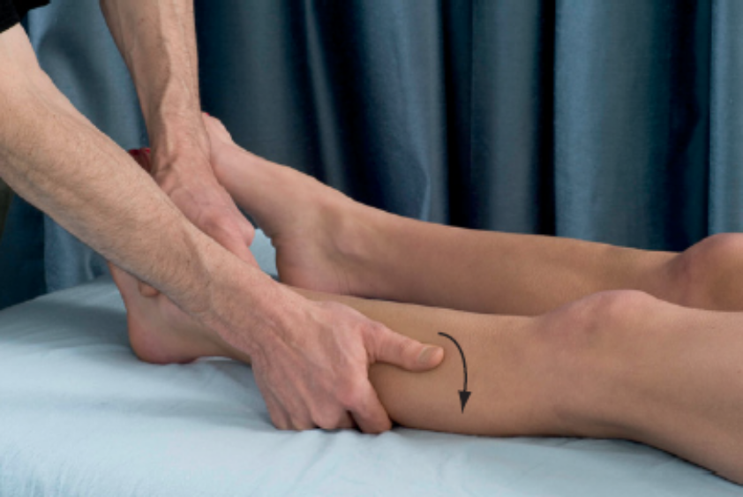
A. Sweeping cross fiber Superficial muscle relaxation and tissue pliability is enhanced with this technique. The thumb applies a sweeping stroke to the anterior compartment muscles that travels diagonally across the fiber direction of the anterior compartment muscles. Longitudinal gliding (effleurage) and broad sweeping cross fiber strokes reduce muscular tension and encourage tissue fluid movement, reducing compartmental pressure.

Slide 14
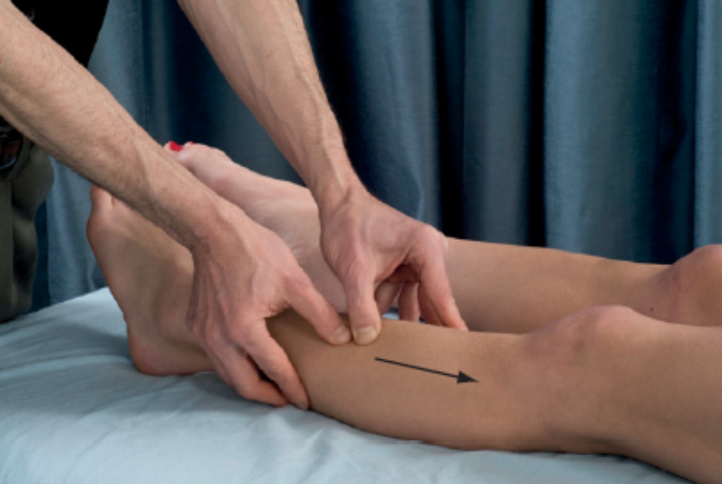
B. Deep longitudinal stripping Tension reduction in the anterior compartment muscles is further enhanced with deep stripping techniques. Stripping can begin with a broad contact surface, such as the heel of the hand or back side of the fist. Following broad contact surface applications, more specific stripping is performed with the fingertips or thumb. Stripping techniques are performed from distal to proximal to follow the direction of venous return.

Slide 15
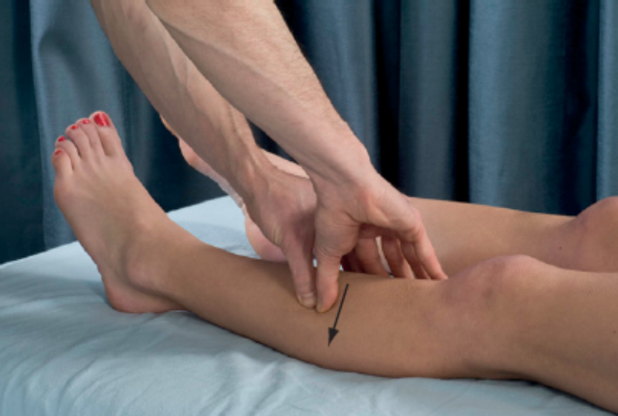
C. Deep broadening Spreading fibers of the anterior compartment muscles helps decrease tension and can reduce overuse that leads to an increase in compartmental pressure. Begin with the thumbs against the lateral tibial border. Apply a moderate amount of pressure through the thumbs and then slowly move laterally until the anterior and lateral leg region has been covered. Start in one location and then gradually treat the entire length of the lower leg with successive strokes.

Slide 16
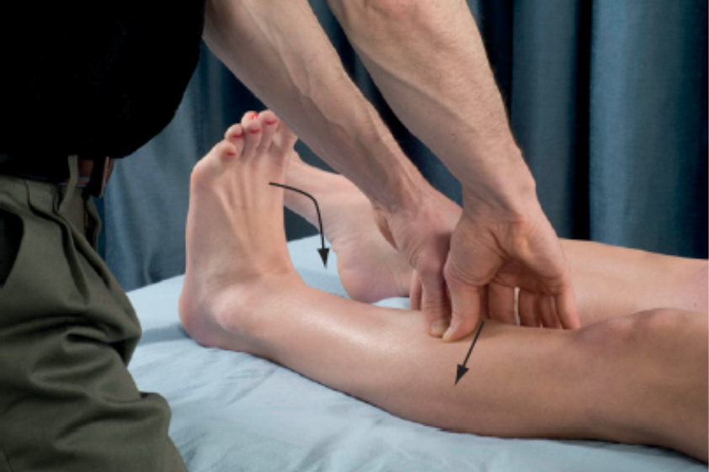
D. Active engagement shortening movements Deeper tissues can be reached for tension reduction with active engagement techniques after the deep broadening methods. Instruct the client to repeatedly dorsiflex and plantar flex the foot and a slow, steady pace. Use the same deep broadening stroke with the thumbs as in C during the dorsiflexion. Pressure is removed as the client plantar flexes the foot and resumes with the next dorsiflexion. Continue this process until the entire anterior compartment region has been treated.

Slide 17
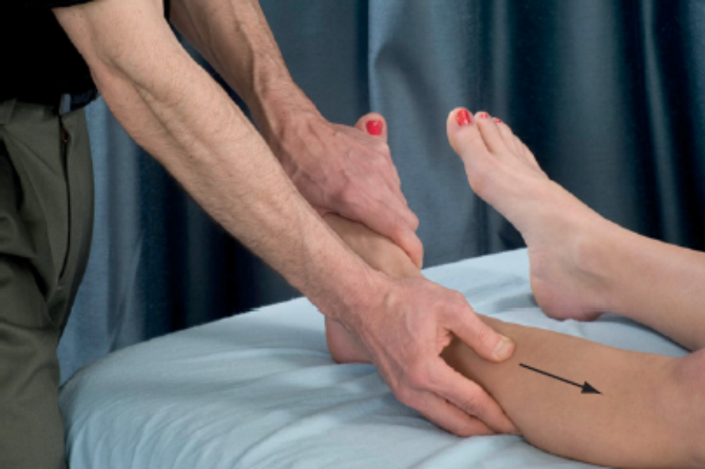
E. Active engagement lengthening movements This technique can follow the shortening movements and is effective for enhancing flexibility and tension reduction in the anterior leg muscles. The same position is used as in D (see above). The client begins the repetitive slow dorsiflexion and plantar flexion movement. Perform a deep stripping technique on the anterior leg muscles as the client is plantar flexing the foot. Pressure is relieved as the foot is dorsiflexed and resumes again on the next plantar flexion. Due to the foot’s position in relation to gravity there are relatively few anterior, leg-muscle fibers recruited to plantar flex the foot during the stripping technique. This technique is more effective if additional resistance is added during the plantar flexion to recruit more fibers.

Slide 18
Rehabilitation protocol considerations
Appropriate pressure level and choice of technique are dependent on the severity of the condition. Perform a comprehensive assessment to determine the severity of the compartment syndrome symptoms.
Active engagement methods are best performed if the condition is not severe to begin with or in the later stages of the rehabilitation process when the client has improved significantly. Use caution when performing the active engagement methods. Active dorsiflexion can increase pressure levels in the anterior compartment and this can provoke greater discomfort. If there is too much discomfort to perform the active engagement stroke, passive engagement methods can be used or simply stick with techniques A, B, and C.

Slide 19
Cautions and contraindications Recognition of the compartment syndrome’s severity is very important in its treatment. If this condition is acute, massage should not be performed, and the individual should be immediately referred to a physician for possible surgical intervention. If at any time during the treatment symptoms are increased, there is cause for concern that the treatment may be aggravating the problem. If this occurs, the current course of treatment should be stopped until the practitioner can re-evaluate the situation. If an acute compartment syndrome has occurred, the generally accepted rehabilitation principle of RICE does not apply to this condition.

