Slide 1
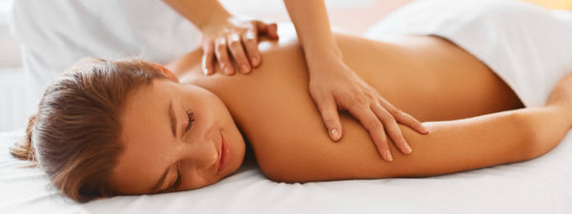
Advanced Techniques 3A
Head, Face and Neck

Slide 2
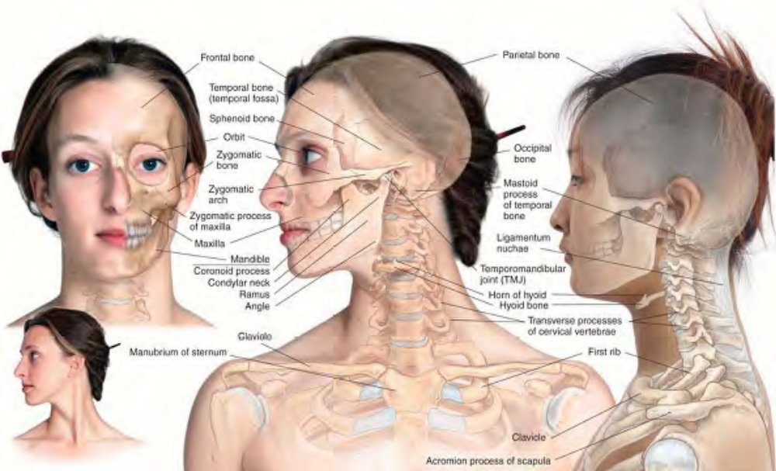
Skeletal features of the anterior and lateral head and neck

Slide 3
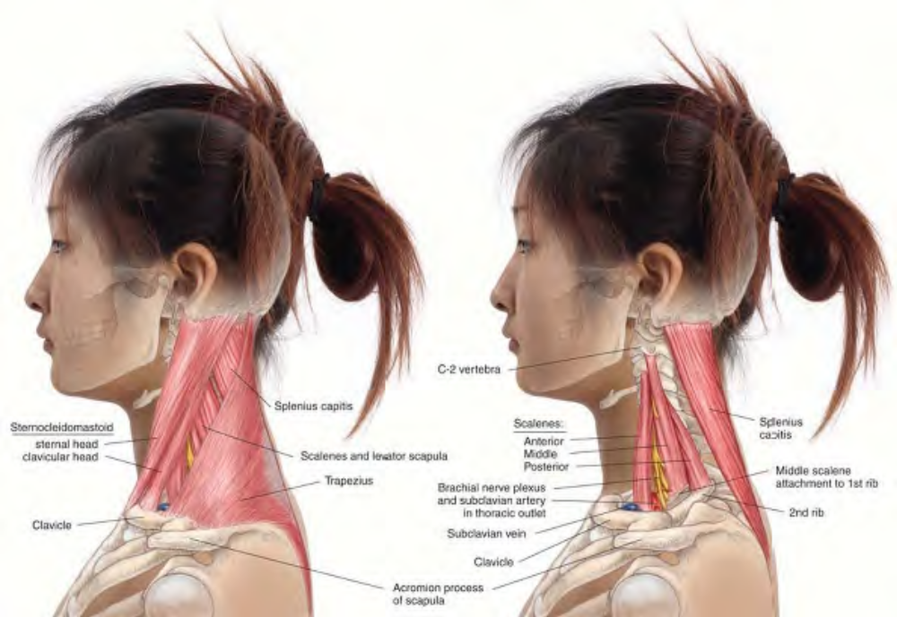
The scalene muscles and lateral neck anatomy

Slide 4
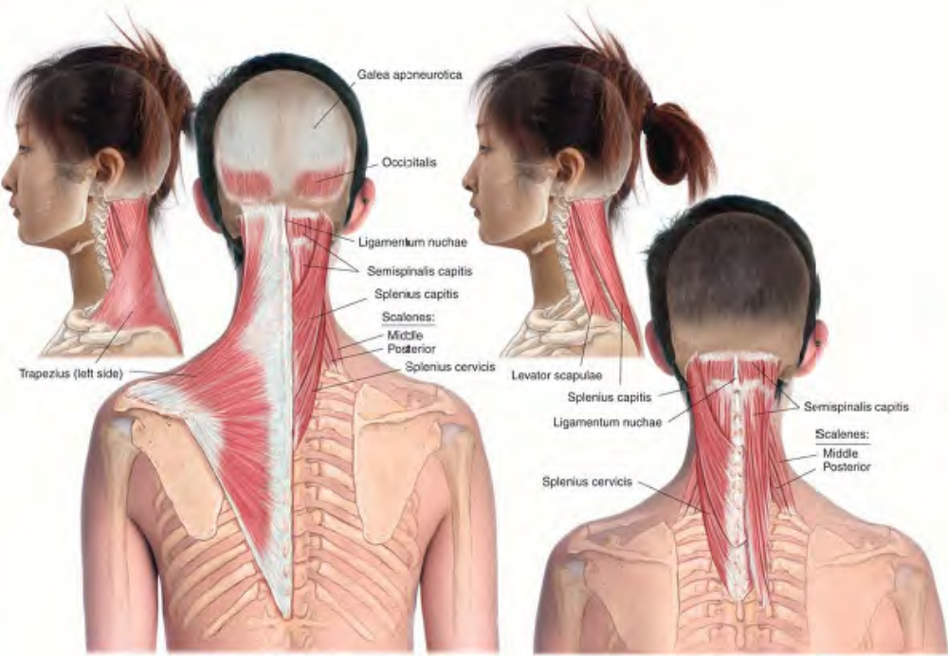
Superficial muscles of the posterior head and neck

Slide 5
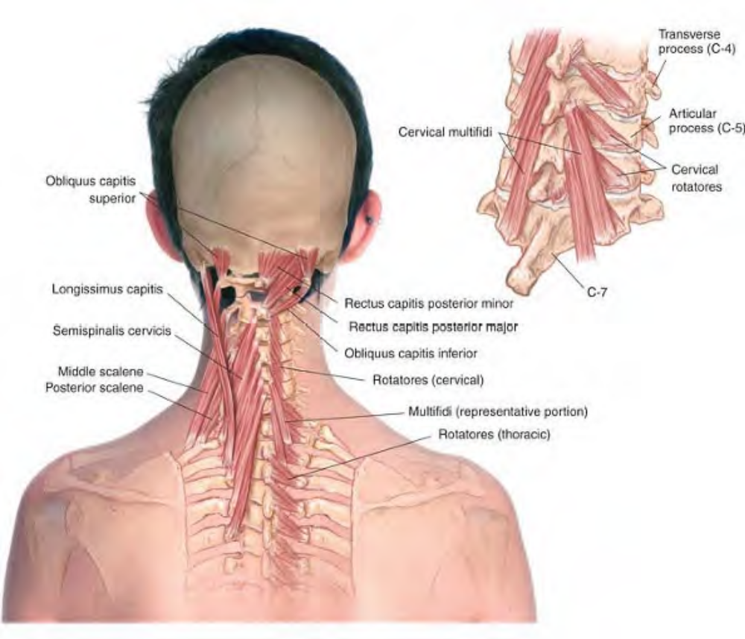
Deep muscles of the neck

Slide 6
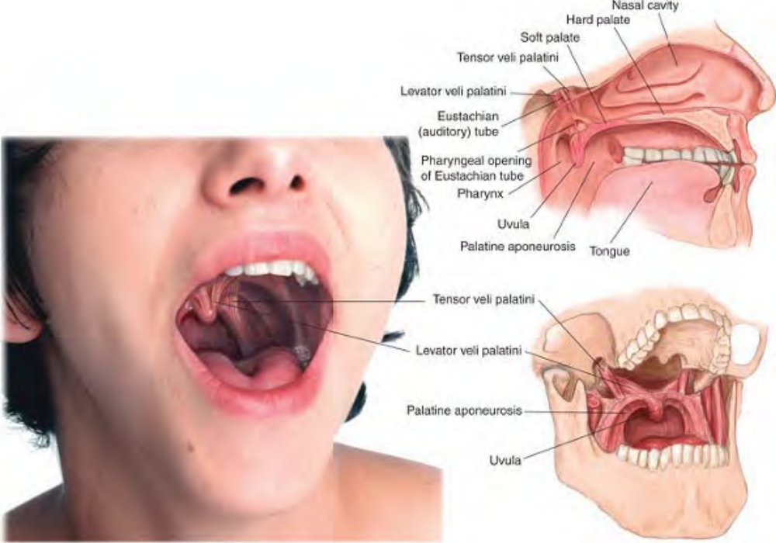
Intraoral anatomy

Slide 7
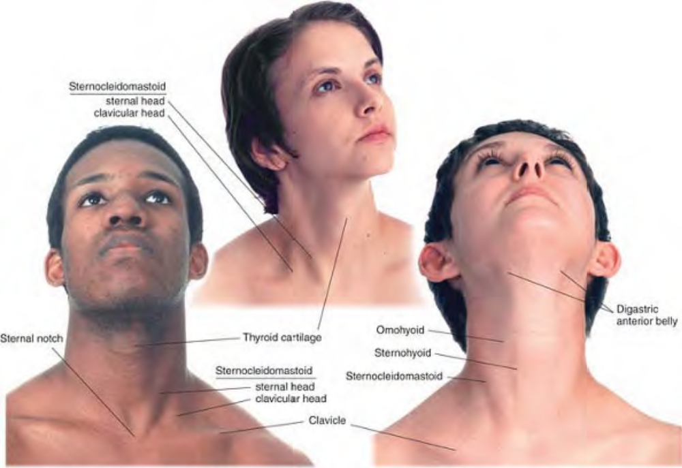
Surface anatomy of the anterior neck

Slide 8
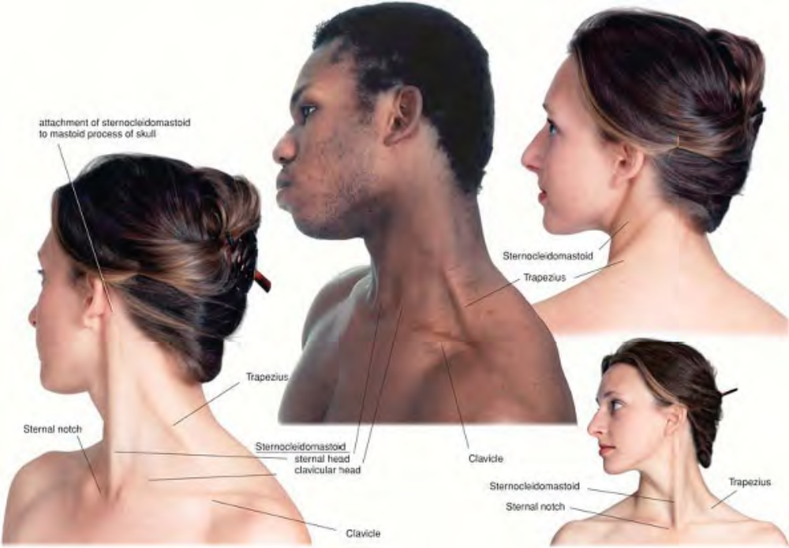
Surface anatomy of the lateral and posterior neck

Slide 9
Overview of the Region
The head is the capital of the body. It is the headquarters. It is worth noting that: The head houses the brain, the control center of the body and according to some, the seat of consciousness. The head is the home of the face. The face tells others who we are and what we are feeling.
The head is the point from which the voice issues. The voice is how we transmit information about ourselves to the rest of the world. The head is the exclusive residence of four of the five traditional senses. The head houses the organs of vision, hearing, taste, and smell. In addition, the head contains the primary organs of balance.
Finally, the head contains the entrance to the respiratory and digestive systems. The two functions that are essential to the sustenance of life, breathing and eating, begin here.

Slide 10
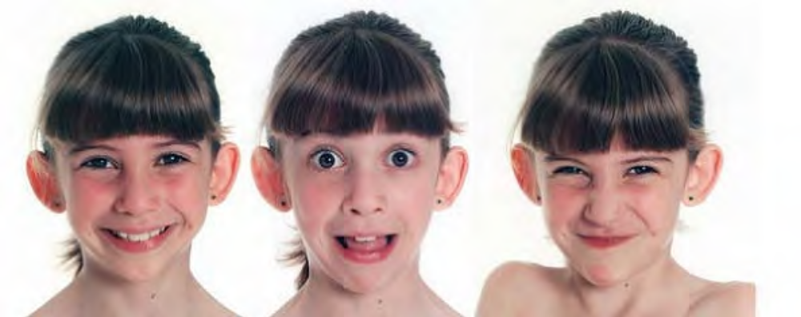
Muscles produce facial expressions

Slide 11
The neck serves two essential functions: It connects the head and its functions to the rest of the body. It supports and moves the head. Clinical observation confirms that many head-aches originate in trigger points in the neck muscles. Such headaches can be reduced in frequency and intensity, if not completely eliminated, by resolution of these trigger points. Many people carry their heads with the ears well forward of the sagittal midline. This misalignment often results in the development of myofascial trigger points in the posterior neck. The head-forward posture activates posterior neck MTrPs [myofascial trigger points] by overloading them, causing chronic contraction without relaxation periods. Note, however, that treatment of the posterior cervical trigger points alone will seldom solve the pain problem. Overall correction of the causes of postural misalignment is required to achieve long-term relief.

Slide 12
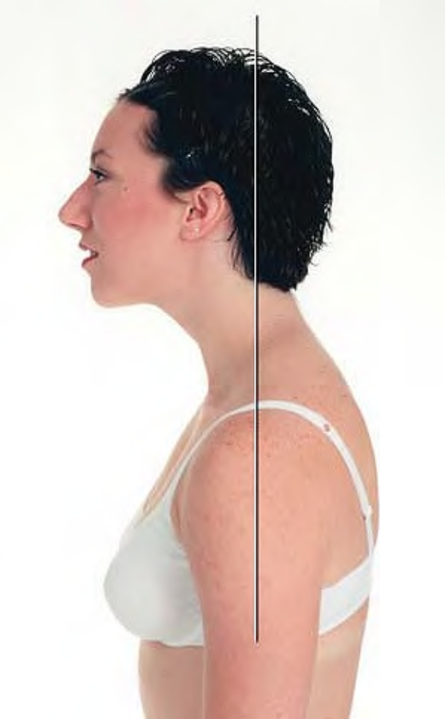
Posture with ear forward of sagittal midline

Slide 13
The skull consists of 22 cranial bones, only one of which, the mandible, is generally considered movable. The cranial bones are joined by sutures and are regarded by most anatomists as being fused. Craniosacral therapists believe that the cranial bones are capable of small but significant movement, and their treatment approach attempts to influence the movement and positioning of these bones. The arguments for and against craniosacral theory are beyond the scope of this book.
The skull itself rests on the first cervical vertebra or atlas; the occipital condyles of the skull rest on two kidney shaped facets on the superior surface of the atlas. The atlas is a bony ring with essentially no body or spine. In turn, the atlas rests on the second cervical vertebra, or axis, which has a toothlike projection, the odontoid process, projecting up into the ring of the atlas. Turning the head consists of rotation around the odontoid process.

Slide 14
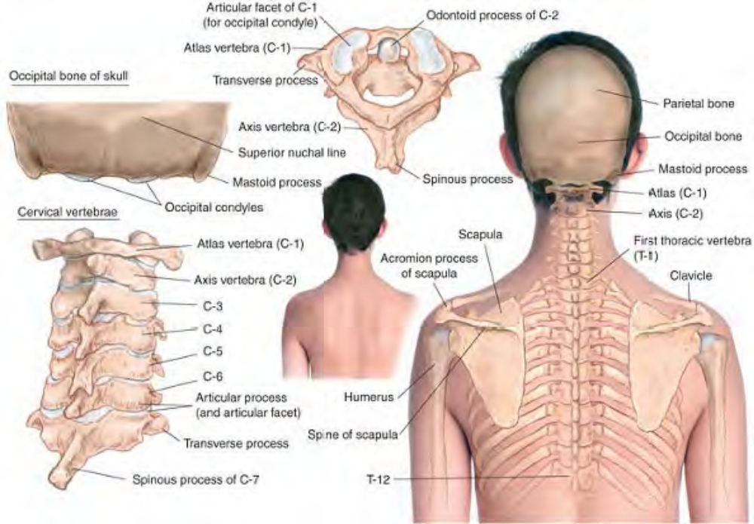
Skeletal features of the posterior head and neck

Slide 15
The head is quite heavy. For this reason, and because of the importance of the mobility of the head for using the senses (particularly vision), the neck muscles are numerous, and many are thick and strong. They are all susceptible to pain and dysfunction.The muscles of the head, face, and neck can be classified as follows:
Scalp muscles, primarily occipitalis and frontalis (or occipitofrontalis, if viewed as one muscle), and the more dorsal aspects of temporalis. These muscles move the scalp and forehead.
Face muscles,involved primarily in controlling facial expressions.
Jaw muscles, which open and close the jaw by moving the mandible.
Neck muscles, which support and balance the head on the spinal column and move it in all directions.

Slide 16
NOTE: Some of the treatment techniques described here require work inside the mouth. Two principles should be observed:
Working inside any body orifice may have emotional implications for the client. Always obtain permission first and discuss any hesitations the client may have. Examination gloves should always be worn when working inside any body orifice.

Slide 17
Frontalis fron-TAL-is
Etymology Latin, pertaining to the front
Overview
Frontalis is sometimes regarded as one belly of the muscle occipitofrontalis, since it is connected directly to the occipitalis by the galea aponeurotica, a tendinous sheet of connective tissue that lies over the skull from front to back. Tightness in either the frontalis or occipitalis muscles, or bellies, therefore produces an overall sense of tightness in the scalp. Note that the frontalis connects partially to the orbicularis oculi both muscles are commonly involved in headaches.
Attachments. Superiorly, to the galea aponeurotica Inferiorly, to the skin over the eyebrow, partially to the orbicularis oculi, and to the root of the nose
Palpation. Press gently with the fingertips on the forehead between the hairline and the eyebrows. The muscle's architecture is parallel, and the fiber direction is superior/inferior. The tighter the muscle, the more palpable it will be.

Slide 18
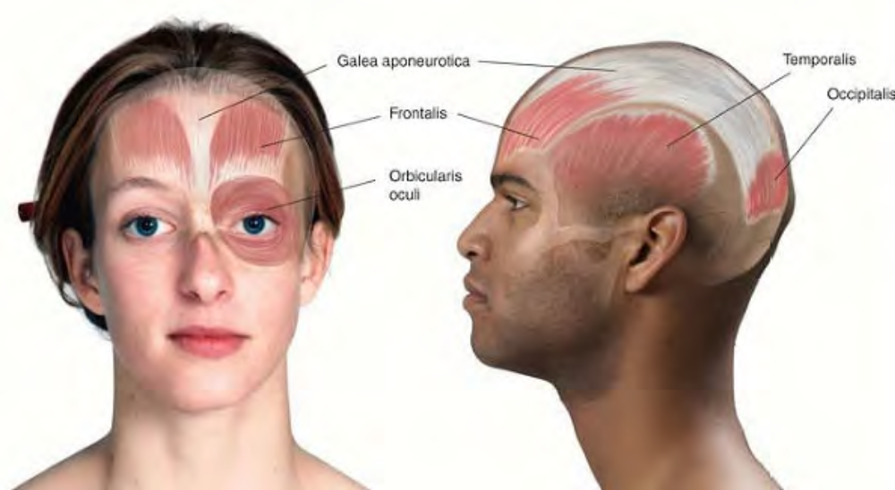
Anatomy of frontalis (occipitofrontalis), and galea aponeurotica

Slide 19
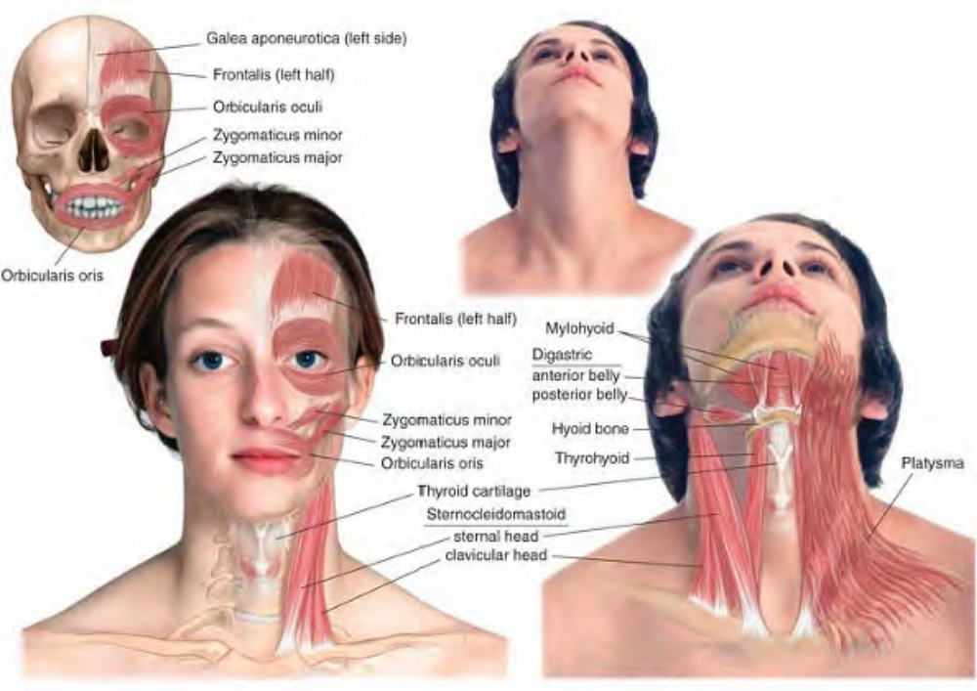
Muscles of the anterior head and neck

Slide 20
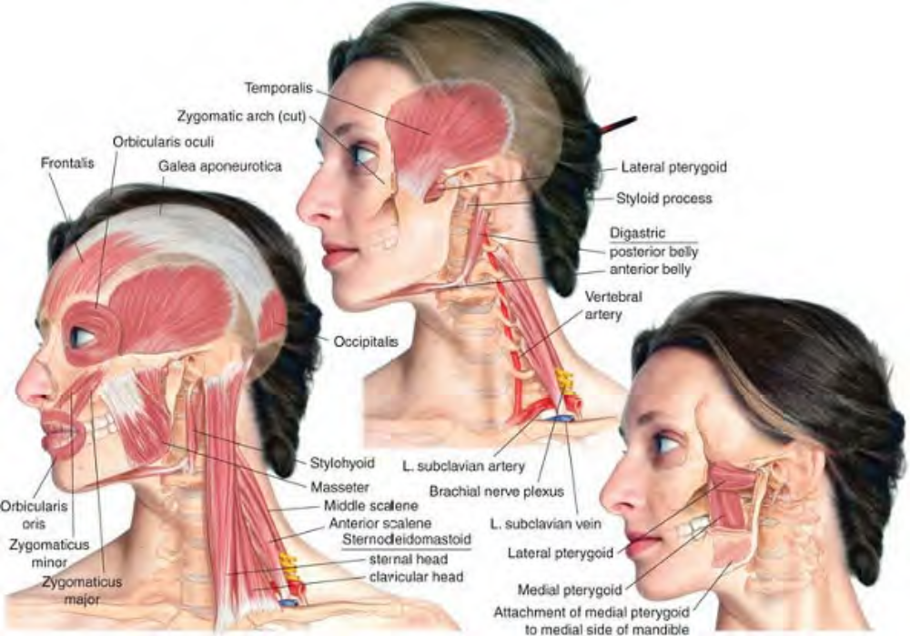
Muscles of the lateral head and neck

Slide 21
Actions. Raises the eyebrow and wrinkles the forehead Working with occipitalis, helps shift the scalp posteriorly, raising the skin of the forehead and causing the hair to stand up, as in horror
Referral Areas. Local, with pain radiating over the forehead
Other Muscles to Examine: Occipitalis, Orbicularis oculi, Temporalis, Sternocleidomastoid, Zygomaticus major, Scalene, Posterior neck muscles

Slide 22
Manual Therapy
Cross-fiber Stroking. The client lies supine. With the fingers spread over the sides of the client's head, place the thumbs at the center of the forehead just over the eyebrows. Pressing firmly into the tissue, slowly spread the thumbs apart until they have covered the forehead to the lateral ridges of the frontal bone. Shifting your hands superiorly, repeat this process as far as the hairline.
Stripping. The client lies supine. Place the tip or flat of the thumb on the forehead at the hairline just next to the center line of the forehead. Pressing firmly into the tissue, slide the thumb inferiorly to the medial end of the eyebrow Shifting your hand laterally, repeat this process as far as the lateral end of the eyebrow.

Slide 23
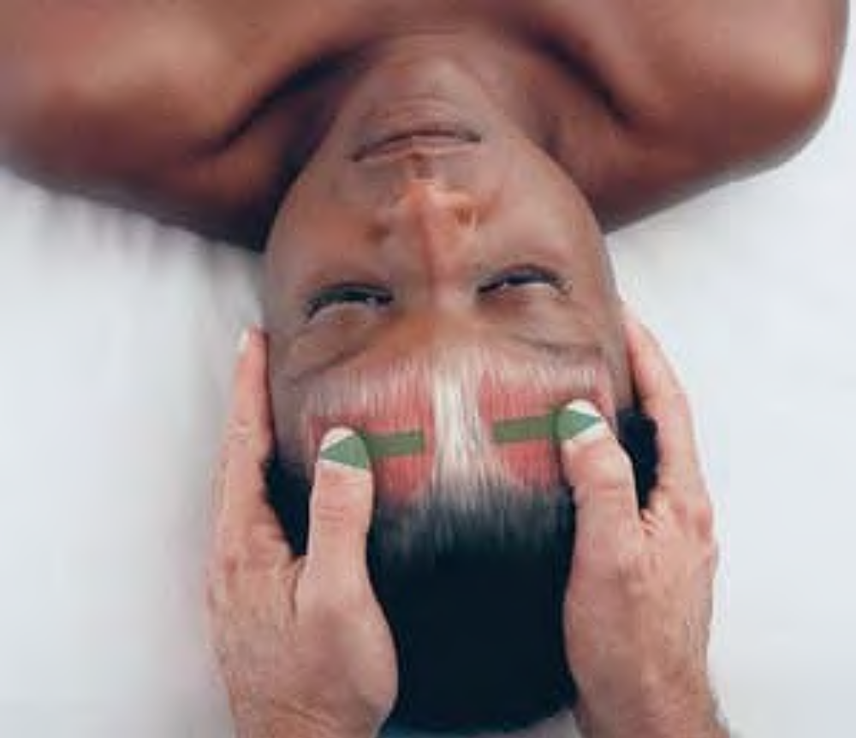
Cross-fiber stroking of frontalis

Slide 24
Occipitalis ock-sip-it-TAL-is
Etymology Latin occiput, back of the head
Overview
Occipitalis: is sometimes regarded as the posterior belly of the muscle occipitofrontalis, since it is connected directly to the frontalis by the galea aponeurotica, a tendinous sheet of connective tissue that lies over the skull from front to back. Tightness in either the frontalis or occipitalis muscles or bellies, therefore, produces an overall sense of tightness in the scalp.
Attachments. Superiorly, to the galea aponeurotica Inferiorly, to the superior nuchal line of the occipital bone
Palpation. Place your fingertips under the head of the supine client directly under the two clearly defined protrusions of the skull. Occipitalis covers these protrusions. The muscle's architecture is parallel, and the fiber direction is superior/inferior.

Slide 25
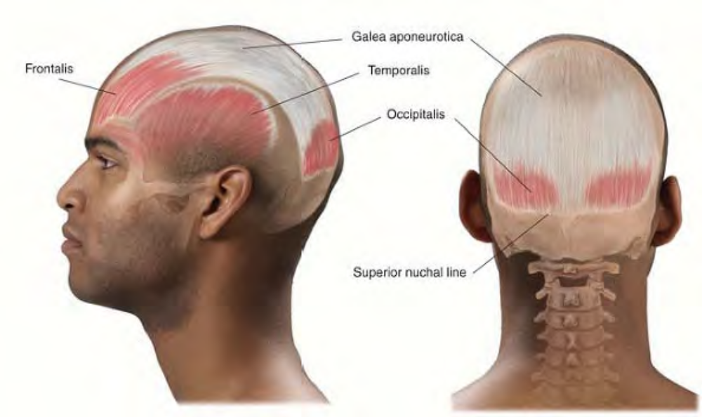
Anatomy of occipitalis

Slide 26
Action. Anchors and retracts the galea aponeurotica, thus pulling the scalp posteriorly. See frontalis for further discussion.
Referral Areas. Radiates pain locally to the back and top of the head and can refer pain to the ipsilateral eye
Other Muscles to Examine. Frontalis, Temporalis, Orbicularis oculi, All lateral and posterior neck muscles

Slide 27
Manual Therapy
Stripping (1). The client lies supine. Place the hands under the head, the fingers curled upward so that the fingertips touch the base of the skull. Pressing superiorly and using the weight of the client's head to generate pressure, draw the hands very slowly toward yourself, so that the fingertips treat the entire occipitalis belly. Pause where the client reports tender points.

Slide 28
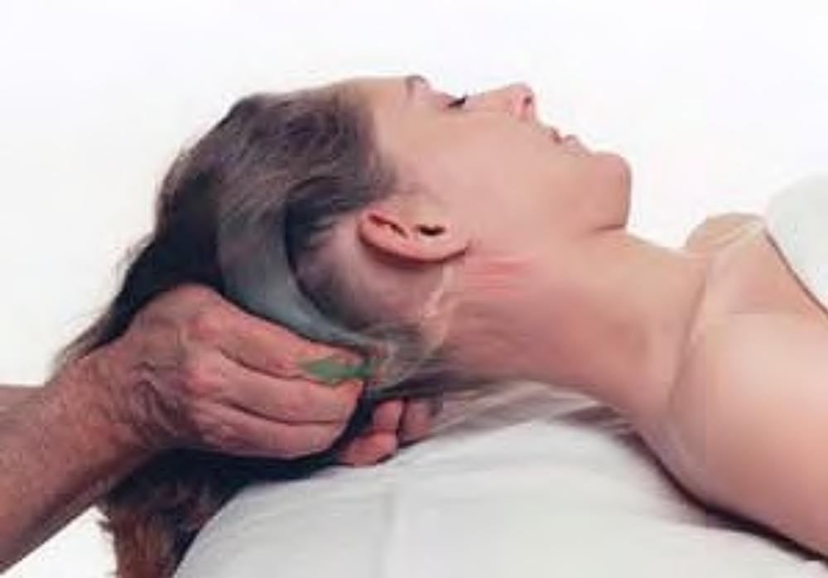
Stripping occipitalis with the fingertips

Slide 29
Stripping (2). The client lies either supine or prone with the head turned away from the therapist. Holding the head with one hand, place the other thumb at the center line of the occiput, on a line with the upper part of occipitalis. Pressing firmly into the tissue, draw the thumb laterally across occipitalis. Placing the thumb in a position closer to the neck, repeat the procedure until you have covered the entire muscle belly.
Stripping (3). The client lies either supine or prone with the head turned away from the therapist. Hold the client's head in both your hands, so that the thumbs rest on the upper part of occipitalis at its center. Pressing firmly into the tissue, spread the thumbs apart as far as the outer aspects of the muscle belly. Shifting the thumbs to a position nearer the neck, repeat the procedure until the whole muscle belly has been treated.

Slide 30
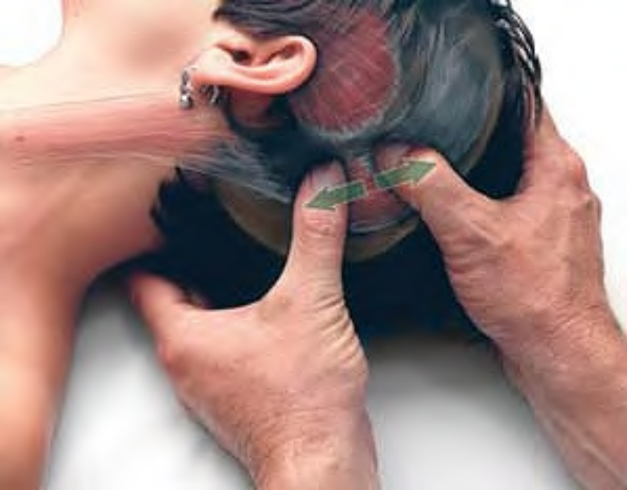
Stripping of occipitalis with thumbs

Slide 31
Orbicularis Oculi or-bic-yu-LAR-is OCK-yu-lee
Etymology Latin: orbiculus, a small disk + oculi, of the eye
Overview
Orbicularis oculi. encircles the eye and provides for voluntary closure of the eyelid. Its trigger points can be activated by frowning and squinting and by trigger points in sternocleidomastoid.
Attachments. Medially, to the medial palpebral ligament, frontal and maxillary bones, and to the tissue of the eyelid Superiorly and medially, to the orbit.
Palpation. Not clearly distinguishable, this muscle surrounds the eye. The muscle's architecture is parallel, and the fiber direction is roughly concentrically around the eye.

Slide 32
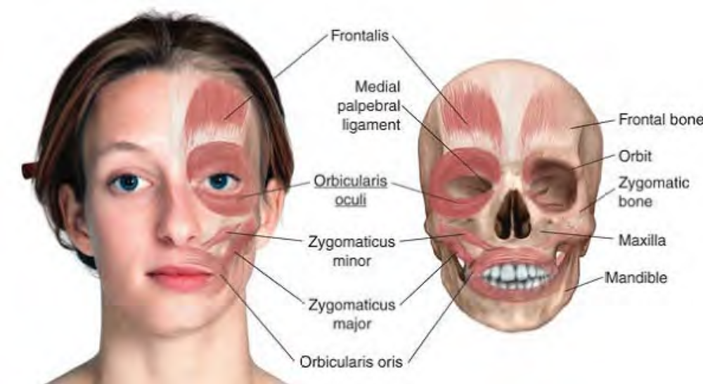
Anatomy of orbicularis oculi

Slide 33
Actions. Intentional blinking and strong closure of the eyelid Squinting.
Referral Areas. Superior to the eye and down the side of the nose.
Manual Therapy
Compression. Using the thumb, seek a common tender or trigger point near the lateral end of the eyebrow. Compress and hold for release.

Slide 34
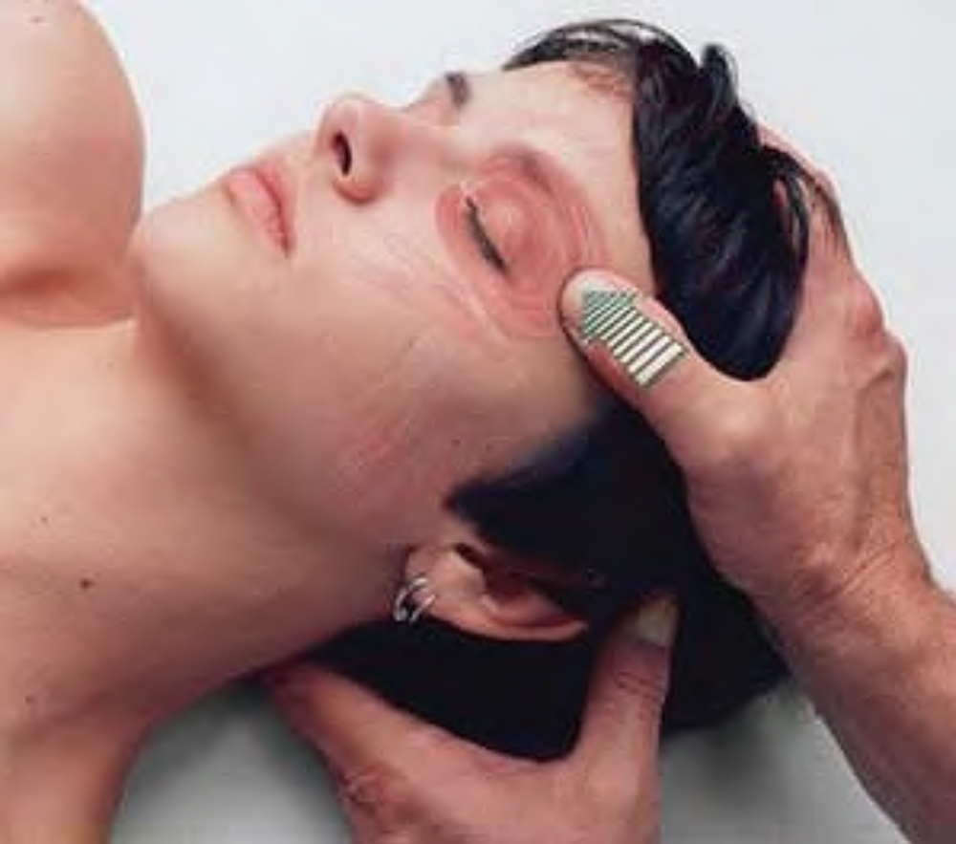
Trigger point compression of orbicularis oculi

Slide 35
Stripping. Place the tip of a thumb or finger on the medial end of the eyebrow.
Pressing firmly into the tissue, slide the thumb or finger outward to the lateral end of the eyebrow.
Repeat once just superior to the eyebrow, and again just inferior to it, pressing superiorly against the orbit.

Slide 36
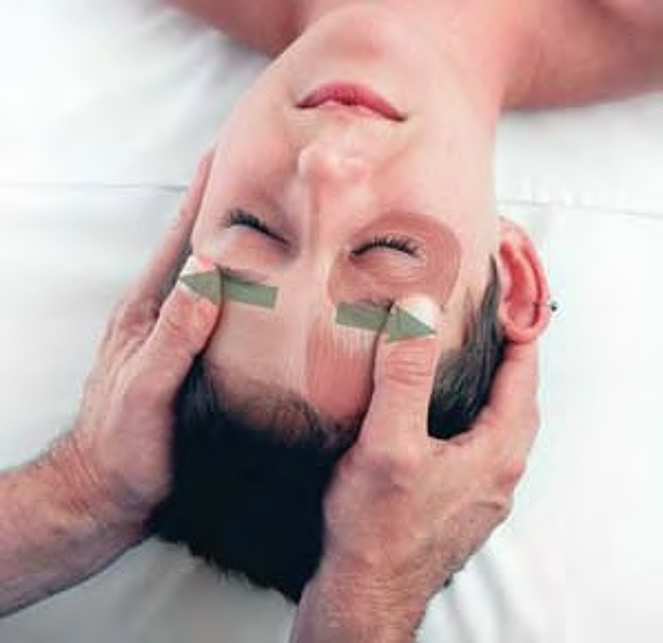
Stripping orbicularis oculi superior to the orbit

Slide 37
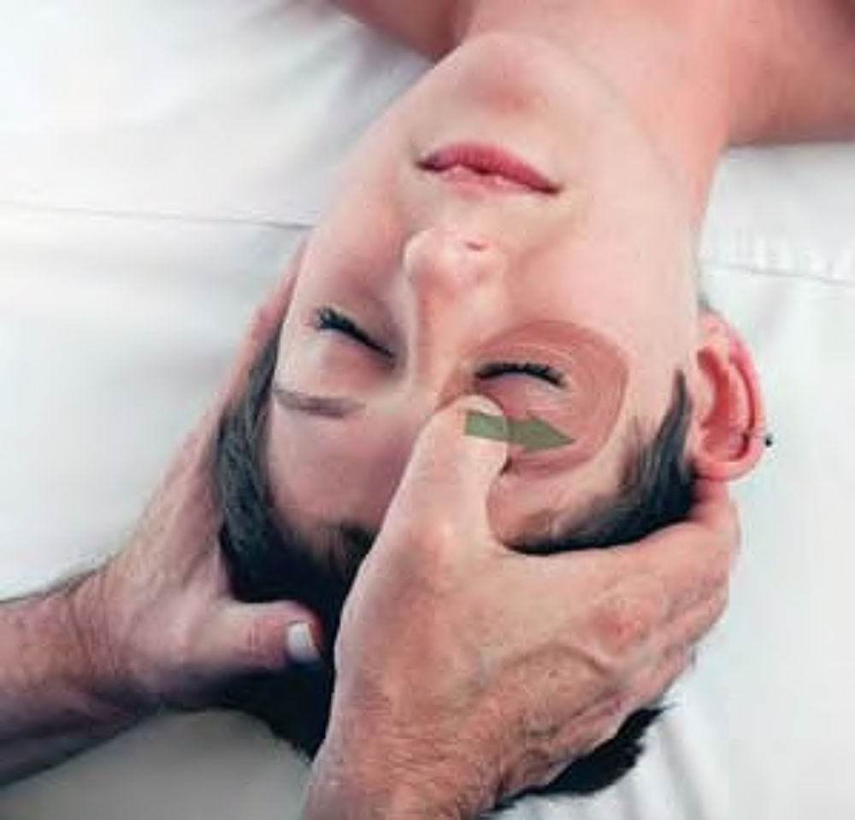
Stripping orbicularis oculi pressing upward against the orbit

Slide 38
Thank you!

