Slide 1

Advanced Massage Techniques 3-B
Zygomatic major & minor, Temporalis, Masseter, Medial & Lateral Pterigoid

Slide 2
Zygomaticus Major and Minor zye-go-MAT-ik-us
Etymology Greek zygon, yoke or joining
Overview
Zygomaticus major and minor are the principal smiling muscles; their trigger points arise from trigger point activity in the chewing muscles (masseter and the pterygoids). It is best examined by pincer palpation with the index finger in the mouth and the thumb outside the mouth, or vice versa.
Attachments: Superiorly, to the zygomatic bone Inferiorly, to the tissues at the corners of the mouth, blending with fibers of orbicularis oris.
Palpation: Place your index fingertip just under the zygomatic prominence with your fourth fingertip resting on the skin over the canine tooth. By moving your fingertips back and fourth, you can feel the muscle clearly. The muscle’s architecture is parallel, and the fiber direction is diagonal.

Slide 3
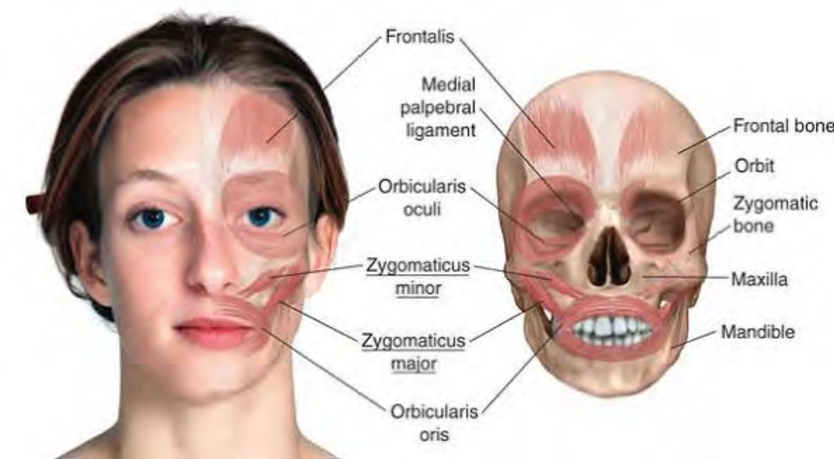
Anatomy of zygomaticus

Slide 4
Action: Pull the corners of the mouth up and back, as in smiling
Referral Areas: Up the cheek and along the side of the nose, past the medial corner of the eye and the eyebrow, and over the medial aspect of the forehead
Other Muscles to Examine : Masseter Pterygoids Orbicularis oculi
Manual Therapy. Stripping: The client lies supine. Place the edge of the thumb against the zygomatic bone (cheekbone). Pressing firmly into the tissue, slide the thumb slowly inferiorly to the corner of the mouth (Fig. 3-13).
Compression: The client lies supine. Place the index finger inside the mouth in the pouch of the cheek. Place the tip of the thumb on the outside of the cheek. Using pincer palpation, explore the length of the muscle for trigger points or tender points. Compress and hold each point until it releases (Fig. 3-14).

Slide 5
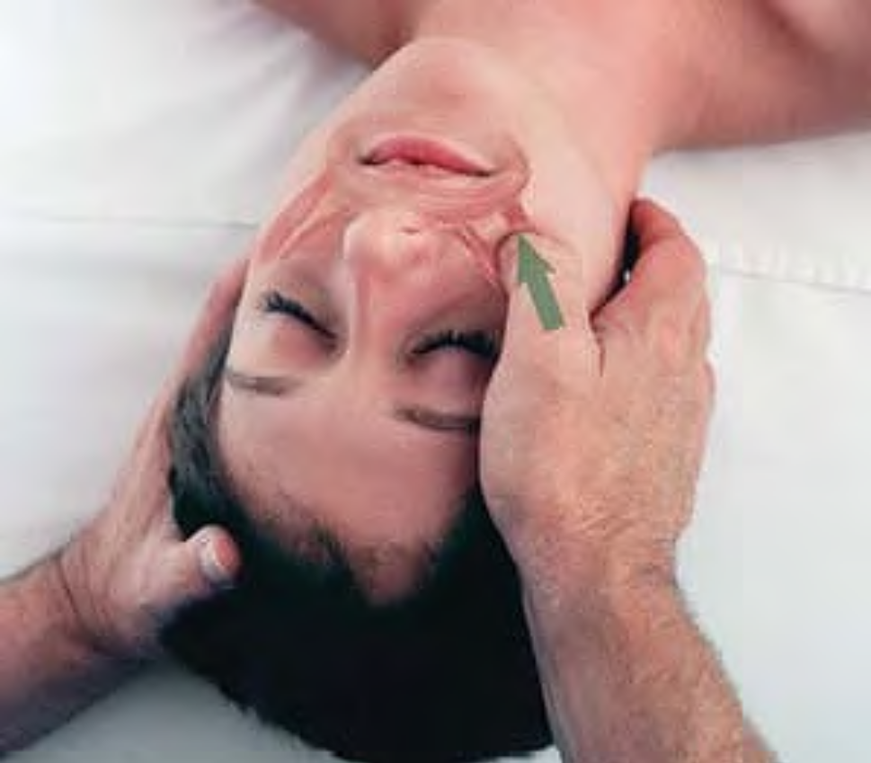
Stripping of zygomaticus

Slide 6
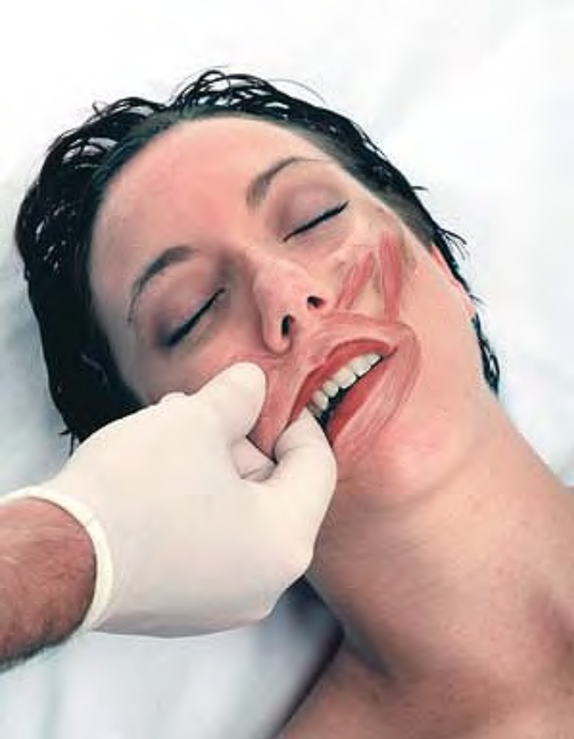
Intraoral pincer compression of zygomaticus

Slide 7
Temporalis TEM-per-AL-is
Etymology Latin, relating to the temple
Overview
Temporalis: is a large, scallop-shaped muscle covering the side of the head in front of, superior to, and behind the ear. It is a muscle of the temporomandibular joint (TMJ). It should be examined and treated in all clients complaining of headaches or TMJ problems. Therapists usually pay a lot of attention to the anterior and middle portions, but the posterior section of the muscle should be addressed as well.
Attachments: Superiorly, to the bone and fascia in the temporal fossa superior to the zygomatic arch Inferiorly, to the coronoid process of the mandible and the anterior edge of the ramus of the mandible

Slide 8
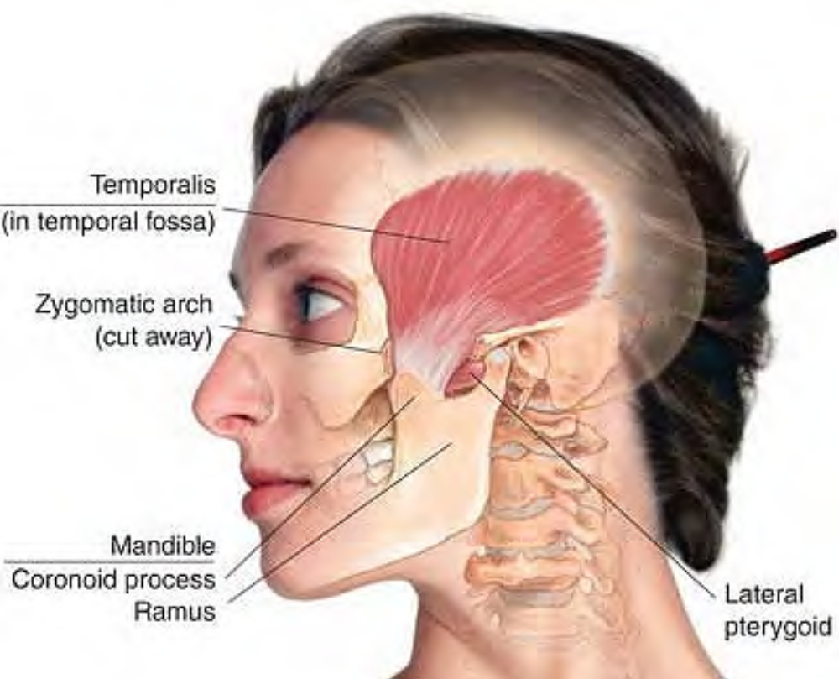
Anatomy of temporalis

Slide 9
Palpation: Temporalis can be palpated between the sphenoid bone and the posterior aspect of the temporal bone down to the zygomatic arch, and a very small amount just below the arch. The muscle's architecture is convergent, and the fiber direction varies from diagonal to superior/inferior. It is scarcely distinguishable when relaxed, but may be distinguished in areas where it is tight.
Actions: Closes the jaw Moves the jaw posteriorly and laterally Maintains the resting position of the mandible
Referral Areas: To all or part of temporal region, eyebrow region, cheek, and incisor and molar teeth.

Slide 10
Other Muscles to Examine: Masseter, Pterygoids, All facial muscles,All anterior, lateral, and posterior neck muscles
Manual Therapy. Stripping: The client lies supine. Place fingertips at top of anterior part of muscle (superior and lateral to eyebrow). Pressing firmly medially, glide the fingertips inferiorly toward zygomatic arch. Place fingertips at the top of the muscle more posteriorly on head. (Note that the muscle is shaped like a scallop, so that it begins higher on the head toward its center, and then lower toward the back of the head.) Repeat movement toward zygomatic arch, pressing firmly. Continue until the entire muscle is covered.
Stroking Across the Fiber (1) : The client lies supine. Place fingertips on sides of client's forehead at the anterior edge of temporal fossa (superior to lateral end of eyebrows).

Slide 11
Pressing firmly, glide the fingertips across the muscle to its posterior edge behind the ear. Moving downward, repeat the procedure to cover the entire muscle.
Stroking Across the Fiber (2): The client lies supine. Hold the client's head in your spread hands, with your thumbs resting together on the anterior aspect of temporalis. Pressing firmly into the muscle with the edges of your thumbs, glide your thumbs apart, so that each thumb slides an inch or two. Move the hands posteriorly, repeating the procedure, until the entire temporalis muscle is covered.

Slide 12
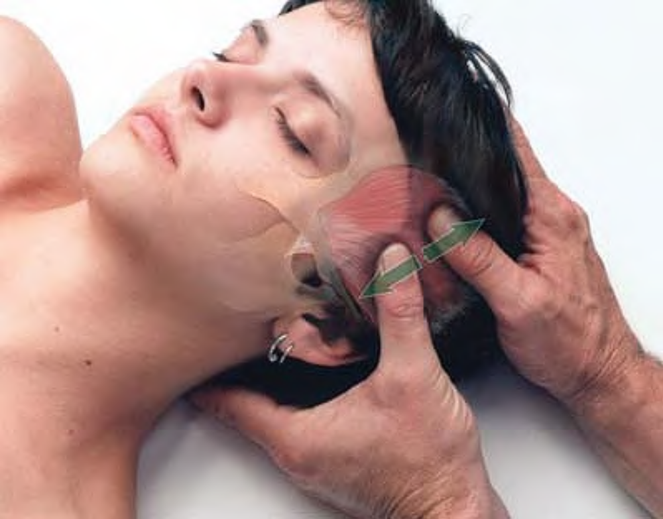
Cross-fiber stroking of temporalis with thumbs

Slide 13
Masseter MASS-e-ter
Etymology Greek, masticator
Overview
Masseter (Fig. 3-17) is the most prominent chewing muscle. It should be treated first in TMJ problems, since it is in an easily accessible position.
Attachments: Superiorly, to zygomatic process of the maxilla and to the zygomatic arch Inferiorly, superficial layer of muscle to external surface of the mandible at its angle and to the inferior half of its ramus; deep layer of muscle to superior half of the ramus, possibly extending to the angle of the mandible
Palpation: Masseter is distinctly palpable from just below the zygomatic arch to the mandible. It is internally palpable by placing the gloved finger in the mouth against the cheek and pressing posteriorly. The muscle's architecture is parallel, and the fiber direction is superior/inferior.
Action: Raises mandible in conjunction with temporalis and pterygoids

Slide 14
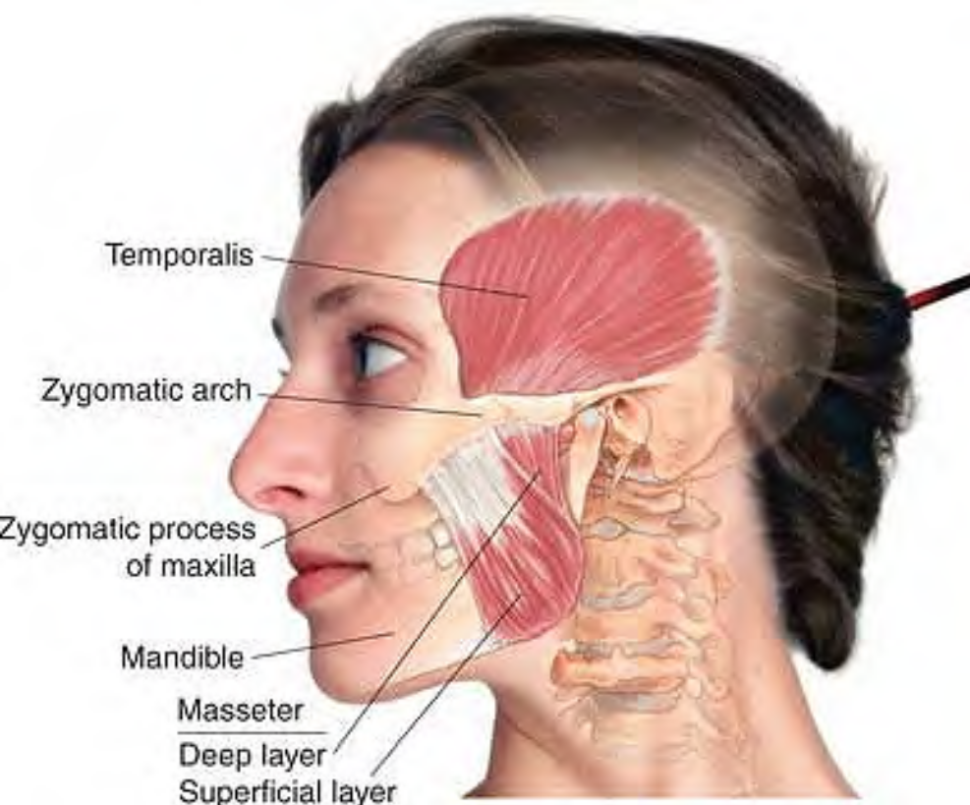
Anatomy of masseter

Slide 15
Referral Areas: To upper and lower jaw, side of face, ear, and superior to eyebrow May also cause tinnitus (ringing in the ears)
Other Muscles to Examine Temporalis Pterygoids All facial muscles All muscles of anterior, lateral, and posterior neck
Manual Therapy. Stripping: The client lies supine. Place the thumb or fingertips at the upper aspect of the muscle, just anterior to the opening of the ear canal. Pressing firmly inward, glide the thumb (Fig. 3-18A) or fingertips (Fig. 3-18B) downward along the length of the muscle to the mandible. Pause at barriers or tender spots until release is felt. Make as many passes as necessary, starting nearest the ear and working forward, to cover the entire muscle (usually one or two passes will suffice). When a great deal of tenderness is present, repeat the above process, beginning lightly and pressing in more deeply each time.

Slide 16
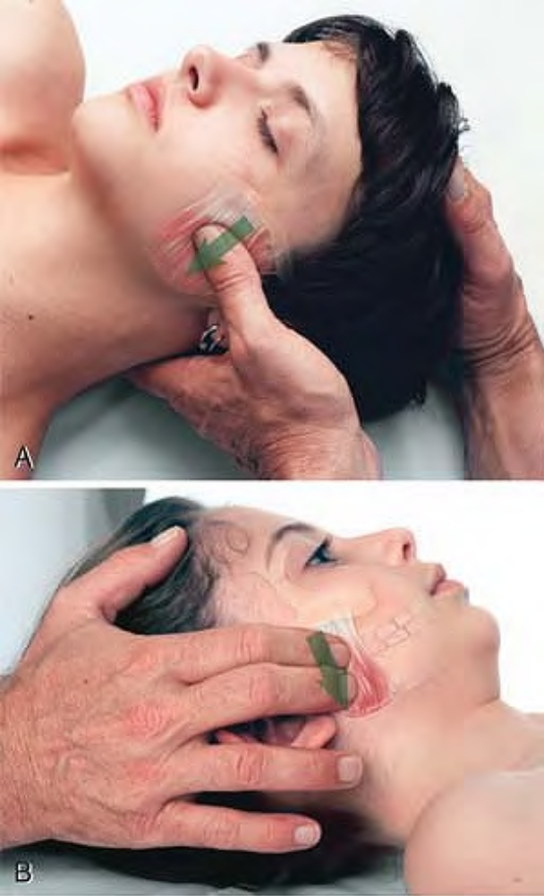
External stripping of masseter (A) with the thumb, (B) with the fingertips

Slide 17
Pterygoids Medial or Internal Pterygoid
Etymology Greek pteryx, wing + eidos, resemblance•
Overview
The pterygoids are jaw (temporomandibular joint, or TMJ) muscles that radiate in a winglike pattern, hence their name. They are a complex set of muscles, with different parts of the muscles participating in all jaw movements, and stabilization of the TMJ. A small part of the lateral pterygoid can be accessed from outside the mouth, whereas the medial pterygoids must be examined and treated intraorally. Examination and treatment of the pterygoid muscles can be somewhat awkward and uncomfortable, but they are often key factors in pain in the jaw, face, and ear. They are also major players in TMJ syndrome.

Slide 18
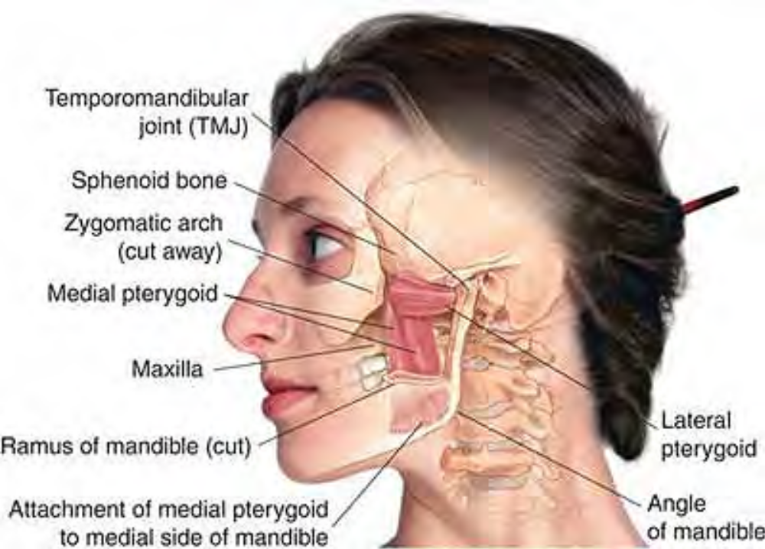
Anatomy of pterygoids

Slide 19
NOTE: The head is anatomically complex, and the attachments of the pterygoids are particularly challenging to illustrate. For this reason, and because these attachments are not necessarily relevant to the massage therapist, not all of them can be seen in the anatomy plates. The student interested in more detail should consult an anatomy atlas.
Medial or Internal Pterygoid
Attachments: Superiorly, to the inner surface of the lateral pterygoid plate and the lateral surface of the palatine bone, and to the maxilla Inferiorly to the lower border of the ra-mus of the mandible, close to the angle of the mandible, and to the medial surface of the ramus of the mandible near the angle.

Slide 20
Palpation: Pterygoids are palpable in three primary areas: (1) directly between the maxilla and mandible anterior to the joint, (2) along the medial surface of the mandible on the lateral aspect of the face, and (3) internally by pressing laterally at the joint of the maxilla and mandible. The muscles' architectures are parallel, and the fiber directions vary.
Actions: Participates in raising the mandible Protracts the mandible Acting alternately, moves the mandible from side to side in grinding motion
Referral Areas: Jaw in front of ear Side of jaw (both outside and inside mouth)

Slide 21
Lateral or External Pterygoid
This muscle has two divisions: superior and inferior. Note that the two divisions of the lateral pterygoid are antagonists.
Attachments: Superior attachments:
Superiorly, to infratemporal crest and inferior lateral surface of greater wing of sphenoid bone
Inferiorly, to lateral surface of lateral pterygoid plate

Slide 22
Inferior attachments:
Superiorly, backward, and somewhat downward toward the TMJ, to the ligament of the joint capsule, the articular disc, and the lateral pterygoid plate of the sphenoid
Inferiorly, diagonally upward to condylar neck and ramus of the mandible just inferior to the joint, to the neck of the mandible, articular disc, and capsule of the temporomandibular joint
Actions
The two divisions of this muscle are involved in raising and lowering the mandible, as well as moving the mandible posteriorly, anteriorly, and laterally. Depresses and protracts the mandible Acting alternately, produces side-to-side grinding

Slide 23
Referral Areas
TMJ region Face around cheekbone
Other Muscles to Examine
Masseter Temporalis
All facial muscles Anterior, posterior, and lateral neck muscles
Manual Therapy. All of the following are performed with the client supine.

Slide 24
External Compression (1)
Use the thumb to find the space just anterior to the TMJ. Compress upward, downward, and forward, seeking tender points. Hold each tender point until it releases.
External Compression (2)
Place the thumb or two fingertips just under the angle of the mandible.
Press superiorly and into the medial surface of the mandible, moving slowly and gently, seeking tender points.
Compress any tender points against the medial surface of the mandible.

Slide 25
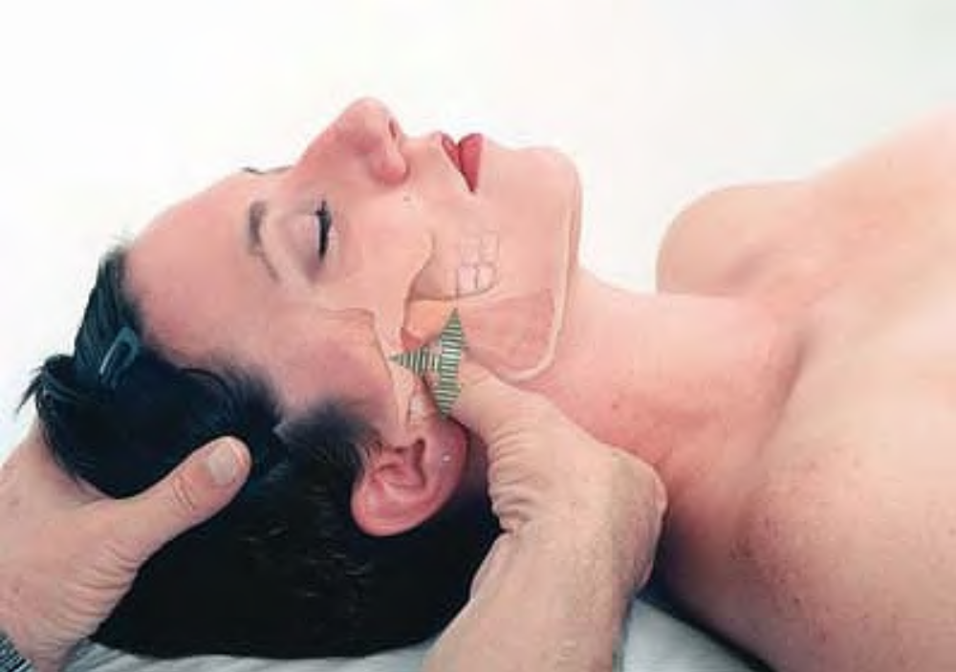
Compression of pterygoids

Slide 26
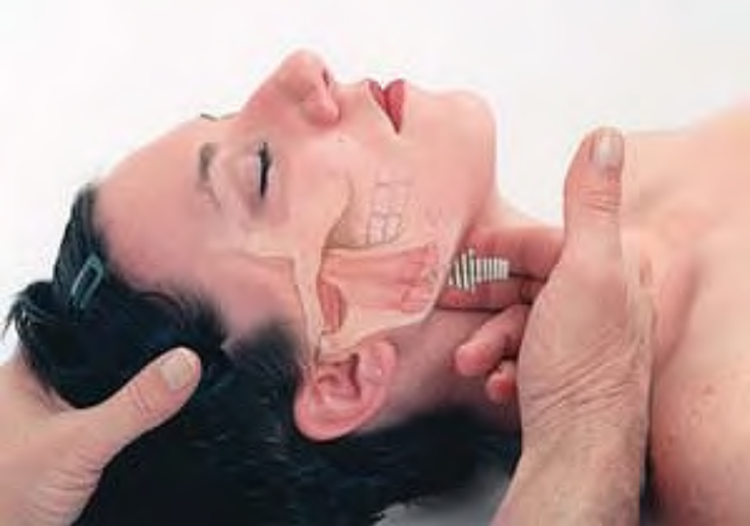
Compression of pterygoids

